Slide 1
Operating Systems: Process Synchronization and Deadlocks

Slide 2
Process Synchronization
Background
The Critical-Section Problem
Synchronization Hardware
Semaphores
Classical Problems of Synchronization
Critical Regions
Monitors
Synchronization in Solaris 2 & Windows 2000

Slide 3
Background
Cooperating processes provide information sharing and computation speedup.
However, it can affect or be affected by other processes executing in the system.
Concurrent access to shared data may result in data inconsistency.
Maintaining data consistency requires mechanisms to ensure the orderly execution of cooperating processes.
Shared-memory solution to bounded-buffer problem allows at most n – 1 items in buffer at the same time. A solution, where all n buffers are used is not simple.
Suppose that we modify the producer-consumer code by adding a variable counter, initialized to 0 and incremented each time a new item is added to the buffer

Slide 4
Bounded-Buffer n-1 solution
#define BUFFER_SIZE 10
Typedef struct {
. . .
} item;
item buffer[BUFFER_SIZE];
int in = 0; //next free position
int out = 0; //first full position
Producer; while (true)
{ while (((in + 1) % BUFFER_SIZE) == out); /* buffer full, do nothing */
buffer[in] = nextProduced;
in = (in + 1) % BUFFER_SIZE;
}
Consumer; while (true)
{ while (in == out) ; /* buffer empty, do nothing */
nextConsumed = buffer[out];
out = (out + 1) % BUFFER_SIZE;
}

Slide 5
Bounded-Buffer n solution
#define BUFFER_SIZE 10
typedef struct {
. . .
} item;
item buffer[BUFFER_SIZE];
int in = 0;
int out = 0;
int counter = 0;
Producer; while (1) {
while (counter == BUFFER_SIZE) ; /* do nothing */
buffer[in] = nextProduced;
in = (in + 1) % BUFFER_SIZE;
counter++;
}
Consumer; while (1) {
while (counter == 0) ; /* do nothing */
nextConsumed = buffer[out];
out = (out + 1) % BUFFER_SIZE;
counter--;
}

Slide 6
Bounded Buffer
The statements counter++; counter--; must be performed atomically.
Atomic operation means an operation that completes in its entirety without interruption.

Slide 7
Bounded Buffer
The statement “counter++” may be implemented in machine language as: register1 = counter
register1 = register1 + 1 counter = register1
The statement “counter- -” may be implemented as: register2 = counter register2 = register2 – 1 counter = register2
Where register1 and register2 may be the same physical accumulator

Slide 8
Bounded Buffer
If both the producer and consumer attempt to update the buffer concurrently, the assembly language statements may get interleaved.
Interleaving depends upon how the producer and consumer processes are scheduled.

Slide 9
Bounded Buffer
Assume counter is initially 5. One interleaving of statements is: producer: register1 = counter (register1 = 5) producer: register1 = register1 + 1 (register1 = 6)
consumer: register2 = counter (register2 = 5) consumer: register2 = register2 – 1 (register2 = 4)
producer: counter = register1 (counter = 6)
consumer: counter = register2 (counter = 4)
The value of counter may be either 4 or 6, where the correct result should be 5.

Slide 10
Race Condition
Race condition: The situation where several processes access and manipulate shared data concurrently. The final value of the shared data depends upon which process finishes last.
To prevent race conditions, concurrent processes must be synchronized.

Slide 11
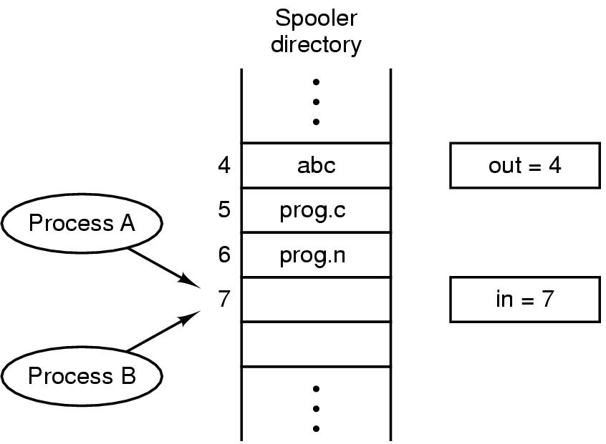
Race Condition
Two processes both want to add a filename to the queue. A gets the current in value of in, is interrupted by the dispatcher. B gets in (same value as A has) writes filename and increases in . When A runs again it uses the old value of in and overwrites what B wrote and sets in to the same value B set it to.
How can one process pass information to another
How to ensure one process does not interfere with another process (e.g. two processes each go after the last MB of memory)
How to properly sequence processes that are dependent upon each other
Last two issues relate to threads as well
Race Conditions: Two processes want to access a shared resource at same time

Slide 12
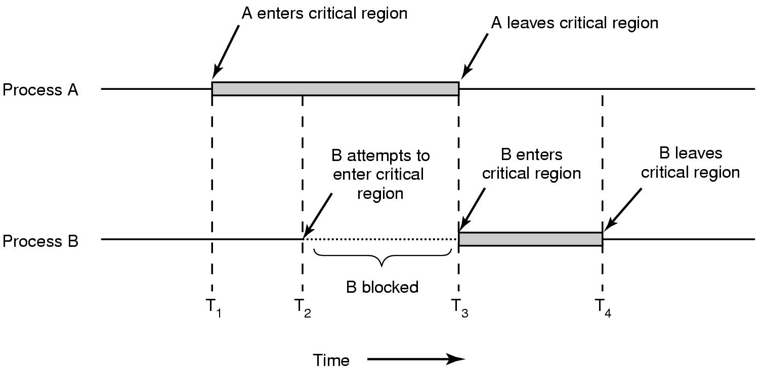
The Critical-Section Problem
n processes all competing to use some shared data
Each process has a code segment, called critical section, in which the shared data is accessed.
Problem – ensure that when one process is executing in its critical section, no other process is allowed to execute in its critical section.

Slide 13
Solution to Critical-Section Problem
A solution must satisfy the following three requirements:
Mutual Exclusion. If process P_{i} is executing in its critical section, then no other processes can be executing in their critical sections.
Progress. If no process is executing in its critical section and there exist some processes that wish to enter their critical section, then the selection of the processes that will enter the critical section next cannot be postponed indefinitely
Bounded Waiting. A bound must exist on the number of times that other processes are allowed to enter their critical sections after a process has made a request to enter its critical section and before that request is granted.
Assume that each process executes at a nonzero speed
No assumption concerning relative speed of the n processes.

Slide 14
Solution to Critical-Section Problem
Design a protocol such that each process must request permission to enter its critical section
The section of code implementing this request is the entry section

Slide 15
Race Conditions in the Kernel
At any point in time, multiple kernel-mode processes may be active with possible race conditions
Kernel data structure maintains list of open files, updated whenever a file is opened or closed
Two processes open files simultaneously, both could try to update the list at the same time
This problem avoided with non-preemptive kernels (Windows XP, traditional UNIX)
Preemptive kernel more suitable for real-time programming as a real-time process can preempt a process currently running in the kernel (Linux 2.6, Solaris)

Slide 16
Initial Attempts to Solve Problem
Only 2 processes, P₀ and P₁
General structure of process P_{i} (other process P_{j})
do {
entry section
critical section
exit section
remainder section
} while (1);
Processes may share some common variables to synchronize their actions.

Slide 17
Algorithm 1
Shared variables:
int turn; initially turn = 0
turn - i ⇒ P_{i} can enter its critical section
do Process P_{i}
{
while (turn != i) ;
critical section
turn = j; //j == 1-i
remainder section
} while (1);
Satisfies mutual exclusion, but not progress – requires strict alternation of processes
If turn == 0 and P₁ is ready to enter its critical section, it can not do so even though P₀ is in its remainder section

Slide 18
Algorithm 2
Algorithm 1 does not retain sufficient information about the state of each process; it only knows which is allowed next into the critical section. Use an array instead.
Shared variables
boolean flag[2]; initially flag [0] = flag [1] = FALSE
flag [i]:= TRUE ⇒ P_{i} ready to enter its critical section
Process P_{i}
do
{ flag[i]= TRUE; while (flag[j]) ; critical section
flag [i] = FALSE;
remainder section
} while (TRUE);
Satisfies mutual exclusion, but not progress requirement – both values could be true at the same time and while loops never terminate

Slide 19
Algorithm 3 – Peterson’s Solution
Combined shared variables of algorithms 1 and 2.
Initially flag[0] == flag[1]==false
Process P_{i}
do {
flag [i]:= TRUE; turn = j; // allows other process to enter CS while (flag [j] and turn = j) ;
critical section
flag [i] = FALSE;
remainder section
} while (TRUE);
Meets all three requirements; solves the critical-section problem for two processes.

Slide 20
Algorithm 3 – Peterson’s Solution
flag[0] == flag[1]==false
Process P₀
do {
flag [0]:= TRUE; turn = 1; while (flag [1] and turn == 1);
critical section
flag [0] = FALSE;
remainder section
} while (TRUE);
Process P₁
do {
flag [1]:= TRUE;
turn = 0;
while(flag [0] and turn == 0) ;
critical section
flag [1] = FALSE;
remainder section
} while (TRUE);

Slide 21
Algorithm 3 – Peterson’s Solution
Mutual exclusion:
each process enters its critical section only if flag[j] == false or turn == i.
both processes can be executing in the critical sections at the same time only if flag[0] == flag[1] == true and turn equals 0 and 1. But turn can have only one value at any point in time. Thus one of the processes could execute the while statement successfully, the other could not as turn would have the wrong value.
Progress requirement and bounded waiting
As soon a P_{i} completes its CS, it changes flag[i] to false. If P_{j} was waiting in its while loop,it set turn to i before it began the loop. Thus, when P_{i} exits its CS, P_{j} can begin as turn has the correct value as well as flag. Thus a process has to wait at most one execution of the CS of the other process before it can begin

Slide 22
Producer Consumer Unsynchronized
ProduceInteger setting sharedInt to 1
ConsumeInteger retrieving sharedInt value 1
ConsumeInteger retrieving sharedInt value 1
ProduceInteger setting sharedInt to 2
ProduceInteger setting sharedInt to 3
ConsumeInteger retrieving sharedInt value 3
ProduceInteger setting sharedInt to 4
ConsumeInteger retrieving sharedInt value 4
ProduceInteger setting sharedInt to 5
ProduceInteger setting sharedInt to 6
ConsumeInteger retrieving sharedInt value 6
ConsumeInteger retrieving sharedInt value 6
ProduceInteger setting sharedInt to 7
ConsumeInteger retrieving sharedInt value 7
ConsumeInteger retrieving sharedInt value 7
ProduceInteger setting sharedInt to 8
ProduceInteger setting sharedInt to 9
ConsumeInteger retrieving sharedInt value 9
ProduceInteger setting sharedInt to 10
ProduceInteger finished producing values
Terminating ProduceInteger
ConsumeInteger retrieving sharedInt value 10
ConsumeInteger retrieved values totaling: 54
Terminating ConsumeInteger

Slide 23
Producer Consumer Synchronized
ProduceInteger setting sharedInt to 1
ConsumeInteger retrieving sharedInt value 1
ProduceInteger setting sharedInt to 2
ConsumeInteger retrieving sharedInt value 2
ProduceInteger setting sharedInt to 3
ConsumeInteger retrieving sharedInt value 3
ProduceInteger setting sharedInt to 4
ConsumeInteger retrieving sharedInt value 4
ProduceInteger setting sharedInt to 5
ConsumeInteger retrieving sharedInt value 5
ProduceInteger setting sharedInt to 6
ConsumeInteger retrieving sharedInt value 6
ProduceInteger setting sharedInt to 7
ConsumeInteger retrieving sharedInt value 7
ProduceInteger setting sharedInt to 8
ConsumeInteger retrieving sharedInt value 8
ProduceInteger setting sharedInt to 9
ConsumeInteger retrieving sharedInt value 9
ProduceInteger setting sharedInt to 10
ProduceInteger finished producing values
Terminating ProduceInteger
ConsumeInteger retrieving sharedInt value 10
ConsumeInteger retrieved values totaling: 55
Terminating ConsumeInteger

Slide 24
Producer Consumer Synchronized Circular Buffer
Produced 1 into cell 0 write 1 read 0 buffer: 1 -1 -1 -1 -1
Produced 2 into cell 1 write 2 read 0 buffer: 1 2 -1 -1 -1
Consumed 1 from cell 0 write 2 read 1 buffer: 1 2 -1 -1 -1
Produced 3 into cell 2 write 3 read 1 buffer: 1 2 3 -1 -1
Produced 4 into cell 3 write 4 read 1 buffer: 1 2 3 4 -1
Produced 5 into cell 4 write 0 read 1 buffer: 1 2 3 4 5
Produced 6 into cell 0 write 1 read 1 buffer: 6 2 3 4 5
BUFFER FULL WAITING TO PRODUCE 7
Consumed 2 from cell 1 write 1 read 2 buffer: 6 2 3 4 5
Produced 7 into cell 1 write 2 read 2 buffer: 6 7 3 4 5
BUFFER FULL WAITING TO PRODUCE 8
Consumed 3 from cell 2 write 2 read 3 buffer: 6 7 3 4 5
Produced 8 into cell 2 write 3 read 3 buffer: 6 7 8 4 5
BUFFER FULL WAITING TO PRODUCE 9
Consumed 4 from cell 3 write 3 read 4 buffer: 6 7 8 4 5
Produced 9 into cell 3 write 4 read 4 buffer: 6 7 8 9 5
BUFFER FULL WAITING TO PRODUCE 10
Consumed 5 from cell 4 write 4 read 0 buffer: 6 7 8 9 5
Produced 10 into cell 4 write 0 read 0 buffer: 6 7 8 9 10
BUFFER FULL
ProduceInteger finished producing values
Terminating ProduceInteger
Consumed 6 from cell 0 write 0 read 1 buffer: 6 7 8 9 10
Consumed 7 from cell 1 write 0 read 2 buffer: 6 7 8 9 10
Consumed 8 from cell 2 write 0 read 3 buffer: 6 7 8 9 10
Consumed 9 from cell 3 write 0 read 4 buffer: 6 7 8 9 10
Consumed 10 from cell 4 write 0 read 0 buffer: 6 7 8 9 10
BUFFER EMPTY
ConsumeInteger retrieved values totaling: 55
Terminating ConsumeInteger

Slide 25
Synchronization Hardware
On many systems, there are simple hardware instructions that can be used in solving the CS problem
If we could prevent interrupts from occurring while a shared variable was being modified the CS problem would be solved
Not feasible in a multiprocessor environment – system efficiency impacted by delays in getting message to all processors not to enter their respective CSs
Many computer systems provide special hardware instructions that enable testing and setting the contents of a word or swapping the contents of two words atomically

Slide 26
TestAndSet() Instruction
TestAndSet - test and modify the content of a word atomically.
If two TestAndSet instructions are executed simultaneously (i.e., in a multiprocessor environment) they will be executed sequentially in some arbitrary order

Slide 27
Mutual Exclusion with Test-and-Set
Shared data: boolean lock = FALSE;
Both operations are indivisible - the CPU locks the memory bus to prohibit other CPUs from accessing memory until it is done
boolean TestAndSet(boolean &target) {
boolean rv = target; //operation 1
target = TRUE; //operation 2
return rv;
}
Process P_{i}
do {
while (TestAndSet(lock));
critical section
lock = FALSE;
remainder section
}

Slide 28
Mutual Exclusion with Swap
Atomically swap two variables. void Swap(boolean &a, boolean &b) {
boolean temp = a;
a = b;
b = temp;
}
Process P_{i}
do {
key = TRUE;
//each process has a local boolean variable
//when lock is false, “while” loop ends and enters CS
//Swap sets lock to true so other processes are blocked
while (key = = TRUE)
Swap(lock,key);
critical section
lock = FALSE;
remainder section
}while (TRUE);

Slide 29
Hardware Synchronization
Advantages
Applicable to any number of processes on either a single processor or multiple processors sharing main memory
Simple and therefore easy to verify
Can be used to support multiple critical section; each CS has its own variable
Disadvantages
Busy waiting is employed, consumes processor time
Starvation is possible since selection of the next process to run waiting on that variable is arbitrary
Deadlock is possible on a single processor machine – P1 executes special instruction and enters CS. P1 is interrupted and P2, which has a higher priority, gets the CPU. P2 can’t execute its CS since P1 is still in its CS – P2 goes into a busy waiting loop. P1,however, will not be dispatched because it has a lower priority than another ready process, P2.

Slide 30
Semaphores – Dijkstra (1965)
Synchronization tool that does not require busy waiting (spinlock).
Easier to generalize to more complex problems
When one process modifies the semaphore value, no other process can simultaneously modify that same semaphore value
Semaphore S
initialized to a non-negative integer value
wait operation decrements the semaphore value (P – proberen:to test)
If the value becomes negative then the process is blocked
signal operation increments the semaphore value (V- verhogen:to increment)
If the value is not positive then a process blocked by a wait is unblocked
A queue is used to hold the processes waiting on the semaphore and they are removed in a FIFO order
Strong semaphore specifies the order in which processes are removed from the queue and guarantees freedom from starvation, a weak semaphore does not specify an order and may be subject to starvation

Slide 31
Two Types of Semaphores
Counting semaphore – integer value can range over an unrestricted domain.
full: counts the number of slots that are full
empty: counts the number of slots empty
Binary semaphore – integer value can range only between 0 and 1; can be simpler to implement.
mutex: makes sure the producer and consumer don’t access the buffer at the same time
Wait() and Signal() are performed atomically

Slide 32
Semaphores – Dijkstra (1965)
Original implementation used busy waiting
wait (S) { signal (S) {
while S <= 0 ; // no-op S++;
S--; }
}
Semaphore value never got below 0
It is limited to the critical sections which should be short sections
There will be little busy waiting if critical section rarely occupied
Note that application programs whose critical sections may be long or almost always occupied are not good candidates for busy waiting.

Slide 33
Semaphore Implementation w/o Busy Waiting
Define a semaphore as a structure
typedef struct {
int value; struct process *L;//list of processes (PCBs)
} semaphore;
Assume two simple operations provided by the OS as system calls:
block() suspends the process that invokes it.
wakeup(P) resumes the execution of a blocked process P.
A negative value for a semaphore indicates how many processes are waiting on that semaphore

Slide 34
Semaphore Implementation
In a uniprocessor environment, we inhibit interrupts while the wait and signal are executing
Semaphore operations now defined as
wait(S): S.value--;
if (S.value < 0) {
add this process to S.L; block(); //suspends process that invoked it
}
signal(S): S.value++;
if (S.value <= 0) {
remove a process P from S.L; wakeup(P);//resumes operation of a blocked process
}

Slide 35
Operations on semaphores
Actions Results
State | Calling Process | Operation |  | Running in Critical Region | Blocked on s | Value of s
0 |  |  |  |  |  | 1
1 | P1 | P(s) |  | P1 |  | 0
2 | P1 | V(s) |  |  |  | 1
3 | P2 | P(s) |  | P2 |  | 0
4 | P3 | P(s) |  | P2 | P3 | -1
5 | P4 | P(s) |  | P2 | P3,P4 | -2
6 | P2 | V(s) |  | P3 | P4 | -1
7 |  |  |  | P3 | P4 | -1
8 | P3 | V(s) |  | P4 |  | 0
9 | P4 | V(s) |  |  |  | 1

Slide 36
Semaphores
Suppose you have two concurrently running process P₁, with a statement S₁ and P₂ with a statement S₂ and it is required that S₂ execute only after S₁ has completed
Both processes share a common semaphore synch initialized to 0
P₁ will contain P₂ will contain
S₁; wait(synch);
signal(synch); S₂;

Slide 37
Critical Section of n Processes
Mutual exclusion implementation with semaphores
Shared data:
semaphore mutex; //initially mutex = 1
Process P_{i}: do { wait(mutex); critical section
signal(mutex); remainder section } while (1);

Slide 38
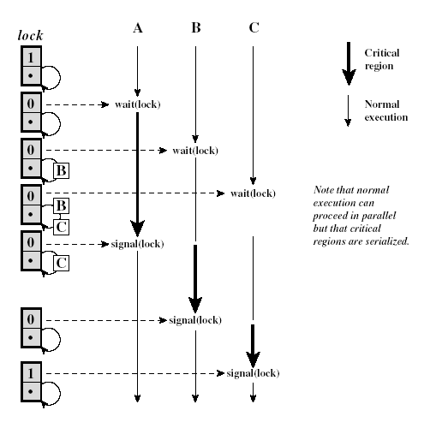
Shared Data Protected by a Semaphore

Slide 39
Deadlock and Starvation
Deadlock – two or more processes are waiting indefinitely for an event that can be caused by only one of the waiting processes – resource acquisition and release
Let S and Q be two semaphores initialized to 1
P₀ P₁
wait(S); wait(Q);
wait(Q); wait(S);
. .
. .
. .
signal(S); signal(Q);
signal(Q); signal(S);
Starvation – indefinite blocking. A process may never be removed from the semaphore queue in which it is suspended (LIFO queue)

Slide 40
Classical Problems of Synchronization
Bounded-Buffer Problem
Readers and Writers Problem
Dining-Philosophers Problem

Slide 41
Bounded-Buffer Problem
Shared data semaphore full, empty, mutex;
pool of n buffers, each can hold one item
mutex provides mutual exclusion to the buffer pool
empty and full count the number of empty and full buffers
Initially: full = 0, empty = n, mutex = 1

Slide 42
Bounded-Buffer Problem
Producer Process Consumer Process
do {
…
produce an item in nextp
…
wait(empty);
wait(mutex);
…
add nextp to buffer
…
signal(mutex);
signal(full);
} while (1);
do {
wait(full)
wait(mutex);
…
remove an item from buffer to nextc
…
signal(mutex);
signal(empty);
…
consume the item in nextc
…
} while (1);

Slide 43
Readers-Writers Problem
Sharing a data object (file or record) among several concurrent processes
If one processes wants to write and another process wants to reads or write, synchronization problems can arise
Require that the writers have exclusive access to the shared object
Shared data semaphore mutex, wrt; Initially mutex = 1, wrt = 1, readcount = 0
readcount keeps track of how many processes are reading the object
mutex provides mutual exclusion for changes to readcount
wrt provides mutual exclusion for the writers
when writer exits and signals wrt, either another waiting writer executes or another waiting reader – the scheduler decides

Slide 44
Readers-Writers Problem
Writer Process Reader Process
wait(wrt);
…
writing is performed
…
signal(wrt);
wait(mutex);
readcount++;
if (readcount == 1)
wait(wrt);
signal(mutex);
…
reading is performed
…
wait(mutex);
readcount--;
if (readcount == 0)
signal(wrt);
signal(mutex):

Slide 45
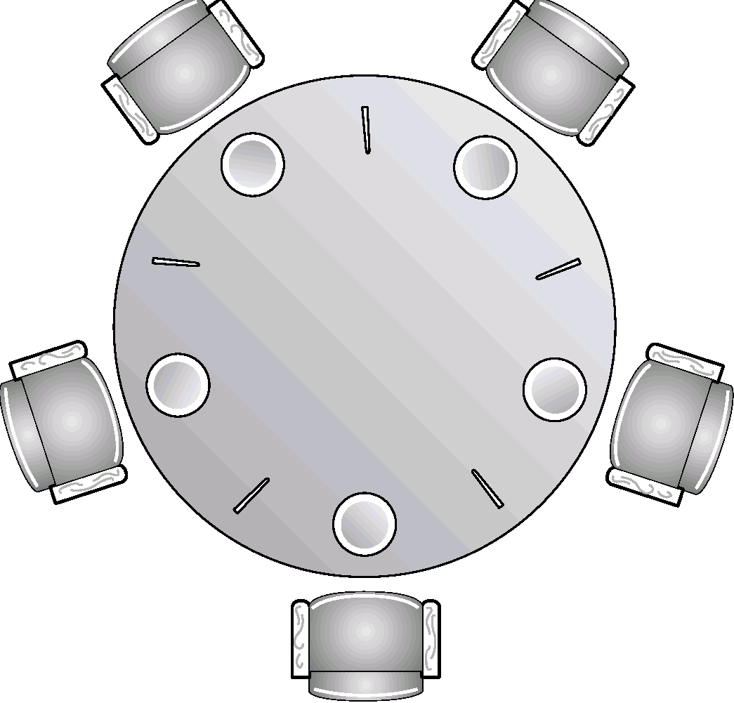
Dining-Philosophers Problem
Processes are competing for exclusive access to a limited number of resources
Philosophers eat/think
Eating needs 2 chopsticks
Pick up one chopstick at a time
How to prevent deadlock
Shared data
semaphore chopstick[5];
Initially all values are 1

Slide 46
Dining-Philosophers Problem
Philosopher i:
do {
wait(chopstick[i])
wait(chopstick[(i+1) % 5])
…
eat
…
signal(chopstick[i]);
signal(chopstick[(i+1) % 5]);
…
think
…
} while (1);
A nonsolution to the dining philosophers problem
All could pick up left fork simultaneously, see right fork not available , put down left fork simultaneously and repeat the process - starvation
Each could wait a random amount of time before pick up right fork but that is not a good solution for all applications
Could use a binary semaphore, would enable only one philosopher to eat at a time

Slide 47
Monitors
Even with semaphores, race conditions can still exist
Semaphores are sensitive to the order in which they are decremented.
Suppose mutex was decremented before empty in the producer’s code. If the buffer was full, the producer would block with mutex = 0. When the consumer runs it finds mutex =0 and block as well. This is deadlock.

Slide 48
Monitors
Monitors are high-level synchronization construct that allows the safe sharing of an abstract data type among concurrent processes.
collection of procedures, variables and data structures that are grouped together in a special kind of module.
processes can enter the monitor by invoking one of its procedures
the monitor’s internal data structures are accessible only by the monitor’s procedures and not by external procedures
Mutual Exclusion: Only one process can be active in a monitor at any instant

Slide 49
Monitors
To implement tailor-made synchronization schemes within a monitor use condition variables along with wait and signal
wait(c) – suspend activation of the calling process on condition c; the monitor is now available for use by another process
signal(c) – resume execution of some process suspended after a wait on the same condition. If there are several such processes, choose one of them. If there are no such processes, do nothing. (different from a semaphore)
The monitor may be entered by invoking any of its procedures, we can think of it as having only one entry point that is guarded so that only one process can be in the monitor at a time
Other processes that attempt to enter join a queue of suspended processes waiting for monitor availability

Slide 50
Monitors
High-level synchronization construct that allows the safe sharing of an abstract data type among concurrent processes.
monitor monitor-name
{
shared variable declarations
condition variable declarations
procedure body P1 (…) {
. . .
}
procedure body P2 (…) {
. . .
}
procedure body Pn (…) {
. . .
}
{
initialization code
}
}

Slide 51
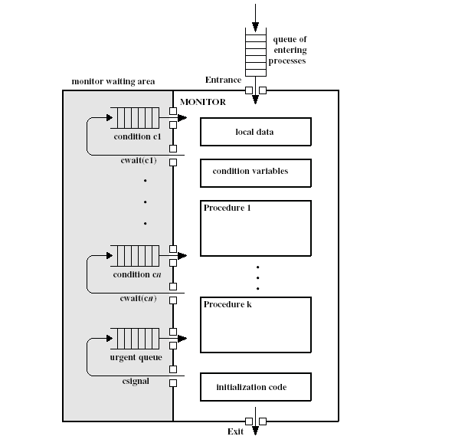
Monitors

Slide 52
Monitors
Java supports user level threads and also allows methods to be grouped together into classes
The keyword synchronized on a method guarantees that once any thread has started executing that method, no other thread will be allowed to start executing any other synchronized method in that class

Slide 53
Monitors
To allow a process to wait within the monitor, a condition variable must be declared, as
condition x, y;
Condition variable can only be used with the operations wait and signal.
The operation
x.wait(); means that the process invoking this operation is suspended until another process invokes it
x.signal();
The x.signal operation resumes exactly one suspended process. If no process is suspended, then the signal operation has no effect.
As with semaphores, it is possible to make mistakes in synchronization but, as all synchronization functions are confined to the monitor, it is easier to verify the correctness of the code

Slide 54
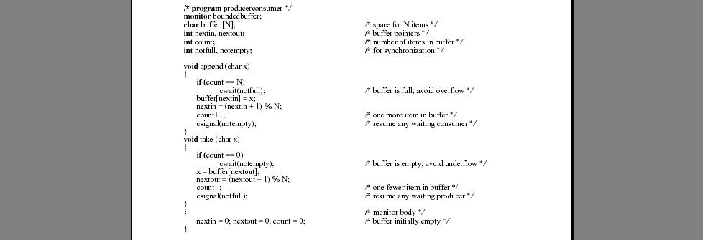
A Solution to the Bounded-Buffer Producer/Consumer Using a Monitor

Slide 55
A Solution to the Bounded-Buffer Producer/Consumer Using a Monitor

Slide 56
Dining Philosophers Example
Philosopher can be in one of 3 states – hungry, eating or thinking
Philosopher can set state to eating only if both neighbors are not eating
Array self is used to delay a hungry philosopher from eating because can’t get both chopsticks
Each philosopher, before starting to eat, must invoke the operation pickup and before ending invoke putdown
dp.pickup(i);
…
eat
…
dp.putdown(i);
No deadlocks will occur but starvation can occur

Slide 57
Dining Philosophers Example
monitor dp
{
enum {thinking, hungry, eating} state[5];
condition self[5];
void pickup(int i)
void putdown(int i)
void test(int i)
void init() {
for (int i = 0; i < 5; i++)
state[i] = thinking;
}

Slide 58
Dining Philosophers
void pickup(int i) {
state[i] = hungry;
test[i];
if (state[i] != eating) self[i].wait();
}
void putdown(int i) {
state[i] = thinking;
// test left and right neighbors
test((i+4) % 5);
test((i+1) % 5);
}
void test(int i) {
if ((state[i] == hungry) && (state[(i + 4) % 5] != eating) &&
(state[(i + 1) % 5] != eating))
{state[i] = eating;
self[i].signal();
}
}
} end of monitor dp
// philosopher i can set its state variable to eating only if the two neighbors are not eating

Slide 59
Dining Philosophers
Initially state[1] for all is set to thinking
Philospher 1 wants to eat: Pickup[1]
state[1] = hungry
Test[1]
State[1] == hungry && state[0] != eating && state[2]!=eating : TRUE
Thus state[1]=eating
Self[1].signal() does nothing
Philosopher 2 wants to eat
State[2] = hungry
Test[2]
State[2] == hungry && state[1] != eating && state[3]!=eating : FALSE
Self[2].wait()
When philosopher 1 is done invokes putdown[1]
state[1] = thinking;
test(0)- if philosopher 0 is hungry and its neighbors are not using their forks it will be put into eating state and signaled
test(2)- if philosopher 2 is hungry and its neighbors are not using their forks it will be put into eating state and signaled

Slide 60
Deadlocks
System Model
Deadlock Characterization
Methods for Handling Deadlocks
Deadlock Prevention
Deadlock Avoidance
Deadlock Detection
Recovery from Deadlock
Combined Approach to Deadlock Handling
Ref: http://userhome.brooklyn.cuny.edu/irudowdky/OperatingSystems.htm & Silberschatz, Gagne, & Galvin, Operating Systems Concepts, 7th ed, Wiley (ch 1-3)

Slide 61
The Deadlock Problem
A set of blocked processes each holding a resource and waiting to acquire a resource held by another process in the set.
Example
System has 2 tape drives.
P₁ and P₂ each hold one tape drive and each needs another one.
Example
semaphores A and B, initialized to 1
P₀ P₁
wait (A); wait(B);
wait (B); wait(A);
Ref: http://userhome.brooklyn.cuny.edu/irudowdky/OperatingSystems.htm & Silberschatz, Gagne, & Galvin, Operating Systems Concepts, 7th ed, Wiley (ch 1-3)

Slide 62
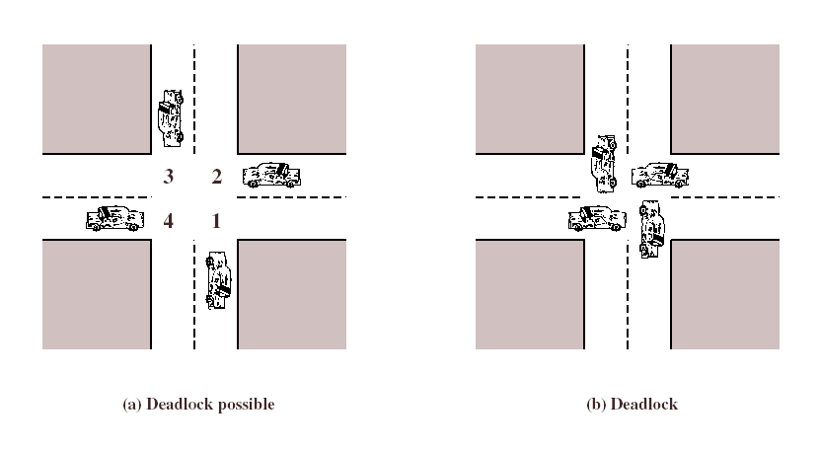
Traffic Deadlock
Ref: http://userhome.brooklyn.cuny.edu/irudowdky/OperatingSystems.htm & Silberschatz, Gagne, & Galvin, Operating Systems Concepts, 7th ed, Wiley (ch 1-3)

Slide 63
Bridge Crossing Example
Traffic only in one direction.
Each section of a bridge can be viewed as a resource.
If a deadlock occurs, it can be resolved if one car backs up (preempt resources and rollback).
Several cars may have to be backed up if a deadlock occurs.
Starvation is possible.
Ref: http://userhome.brooklyn.cuny.edu/irudowdky/OperatingSystems.htm & Silberschatz, Gagne, & Galvin, Operating Systems Concepts, 7th ed, Wiley (ch 1-3)

Slide 64
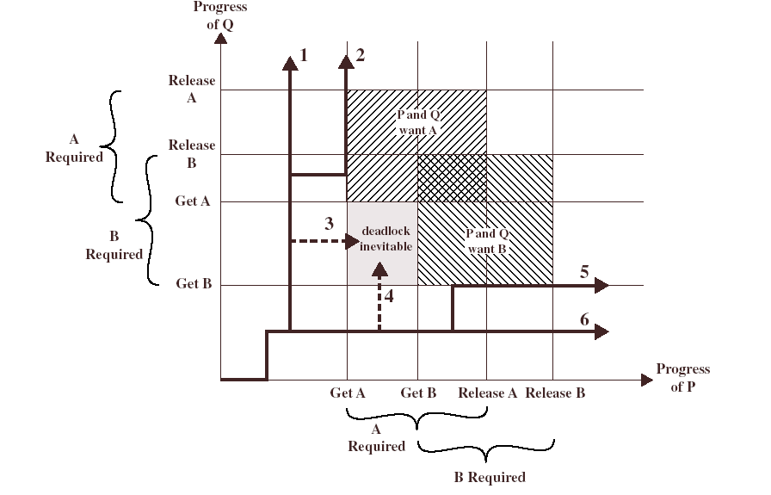
Computer Processes and Resources Deadlock
Ref: http://userhome.brooklyn.cuny.edu/irudowdky/OperatingSystems.htm & Silberschatz, Gagne, & Galvin, Operating Systems Concepts, 7th ed, Wiley (ch 1-3)

Slide 65
Deadlock Characterization
Deadlock can arise if these four conditions hold simultaneously
Mutual exclusion: only one process at a time can use a resource – resources are nonsharable.
Hold and wait: a process holding at least one resource is waiting to acquire additional resources held by other processes.
No preemption: a resource can be released only voluntarily by the process holding it, after that process has completed its task.
Circular wait: there exists a set {P₀, P₁, …, P₀} of waiting processes such that P₀ is waiting for a resource that is held by P₁, P₁ is waiting for a resource that is held by P₂, …, P_{n–1} is waiting for a resource that is held by P_{n}, and P_{n} is waiting for a resource that is held by P₀.
Ref: http://userhome.brooklyn.cuny.edu/irudowdky/OperatingSystems.htm & Silberschatz, Gagne, & Galvin, Operating Systems Concepts, 7th ed, Wiley (ch 1-3)

Slide 66
Resource-Allocation Graph
Deadlocks can be described more precisely in terms of a directed graph consisting of a set of vertices V and a set of edges E
V is partitioned into two types:
P = {P₁, P₂, …, P_{n}}, the set consisting of all the processes in the system.
R = {R₁, R₂, …, R_{m}}, the set consisting of all resource types in the system.
request edge – directed edge P_{i} → R_{j}
assignment edge – directed edge R_{j} → P_{i}
Ref: http://userhome.brooklyn.cuny.edu/irudowdky/OperatingSystems.htm & Silberschatz, Gagne, & Galvin, Operating Systems Concepts, 7th ed, Wiley (ch 1-3)

Slide 67
Resource-Allocation Graph (Cont.)
Process
Resource Type with 4 instances
P_{i} requests instance of R_{j}
P_{i} is holding an instance of R_{j}
P_{i}
R_{j}
P_{i}
R_{j}
Ref: http://userhome.brooklyn.cuny.edu/irudowdky/OperatingSystems.htm & Silberschatz, Gagne, & Galvin, Operating Systems Concepts, 7th ed, Wiley (ch 1-3)

Slide 68
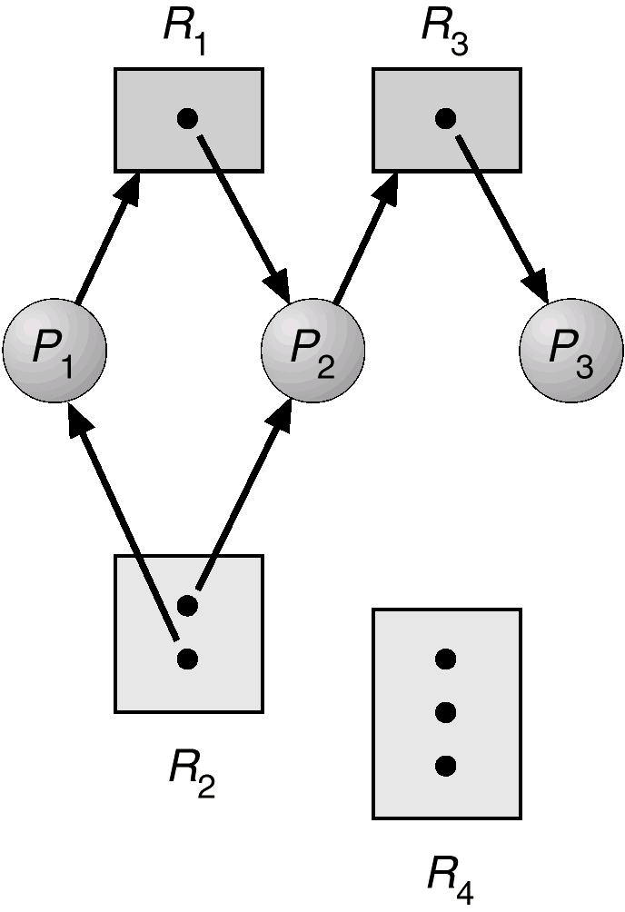
Example of a Resource Allocation Graph
Set P contains …
Set R contains …
Set E contains …
How many of instances of each resource are there?
What is each process holding and requesting?
Ref: http://userhome.brooklyn.cuny.edu/irudowdky/OperatingSystems.htm & Silberschatz, Gagne, & Galvin, Operating Systems Concepts, 7th ed, Wiley (ch 1-3)

Slide 69
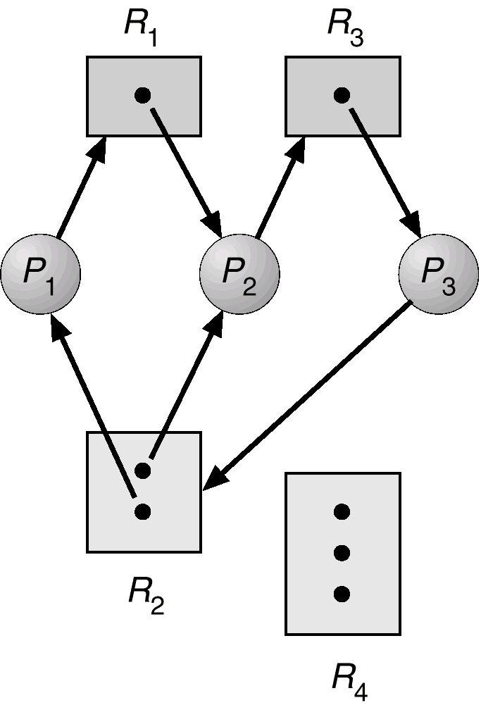
Resource Allocation Graph With A Deadlock
What are the cycles?
P1->R1->P2->R3->P3->R2-> P1
P2->R3->P3->R2->P2
Process P1,P2 and P3 are deadlocked
Ref: http://userhome.brooklyn.cuny.edu/irudowdky/OperatingSystems.htm & Silberschatz, Gagne, & Galvin, Operating Systems Concepts, 7th ed, Wiley (ch 1-3)

Slide 70
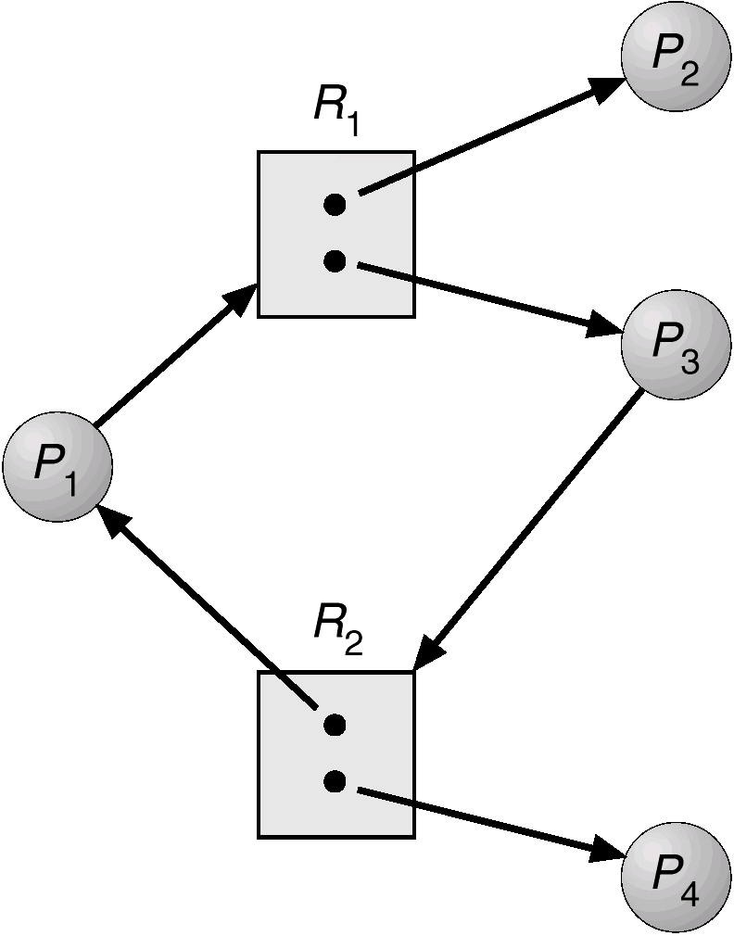
Resource Allocation Graph With A Cycle But No Deadlock
Cycle:
P1->R1->P3->R2->P1
No deadlock as P4 can release R2 which can they be allocated to P3 breaking the cycle
Ref: http://userhome.brooklyn.cuny.edu/irudowdky/OperatingSystems.htm & Silberschatz, Gagne, & Galvin, Operating Systems Concepts, 7th ed, Wiley (ch 1-3)

Slide 71
Basic Facts
If graph contains no cycles ⇒ no deadlock.
If graph contains a cycle ⇒
if only one instance per resource type, then deadlock.
if several instances per resource type, possibility of deadlock.
Ref: http://userhome.brooklyn.cuny.edu/irudowdky/OperatingSystems.htm & Silberschatz, Gagne, & Galvin, Operating Systems Concepts, 7th ed, Wiley (ch 1-3)

Slide 72
Methods for Handling Deadlocks
Ensure that the system will never enter a deadlock state.
Allow the system to enter a deadlock state and then recover.
Ignore the problem and pretend that deadlocks never occur in the system; used by most operating systems, including UNIX and Windows
Ref: http://userhome.brooklyn.cuny.edu/irudowdky/OperatingSystems.htm & Silberschatz, Gagne, & Galvin, Operating Systems Concepts, 7th ed, Wiley (ch 1-3)

Slide 73
Deadlock Prevention
Restrain the ways request can be made.
Mutual Exclusion – not required for sharable resources; must hold for nonsharable resources.
Hold and Wait – must guarantee that whenever a process requests a resource, it does not hold any other resources.
Require process to request and be allocated all its resources before it begins execution,
Or, allow process to request resources only when the process has none. If additional resources are needed, the process must release all resources it currently holds
Low resource utilization; starvation possible.
Ref: http://userhome.brooklyn.cuny.edu/irudowdky/OperatingSystems.htm & Silberschatz, Gagne, & Galvin, Operating Systems Concepts, 7th ed, Wiley (ch 1-3)

Slide 74
Deadlock Prevention (Cont.)
No Preemption
If a process that is holding some resources requests another resource that cannot be immediately allocated to it, then all resources currently being held are released.
Preempted resources are added to the list of resources for which the process is waiting.
Process will be restarted only when it can regain its old resources, as well as the new ones that it is requesting.
Circular Wait
impose a total ordering of all resource types, and require that each process requests resources in an increasing order of enumeration.
It is up to the application developer to write programs that follow the ordering.
Ref: http://userhome.brooklyn.cuny.edu/irudowdky/OperatingSystems.htm & Silberschatz, Gagne, & Galvin, Operating Systems Concepts, 7th ed, Wiley (ch 1-3)

Slide 75
Deadlock Avoidance
Requires that the system has some additional a priori information available.
Simplest and most useful model requires that each process declare the maximum number of resources of each type that it may need.
The deadlock-avoidance algorithm dynamically examines the resource-allocation state to ensure that there can never be a circular-wait condition.
Resource-allocation state is defined by the number of available and allocated resources, and the maximum demands of the processes.
Ref: http://userhome.brooklyn.cuny.edu/irudowdky/OperatingSystems.htm & Silberschatz, Gagne, & Galvin, Operating Systems Concepts, 7th ed, Wiley (ch 1-3)

Slide 76
Safe State
When a process requests an available resource, system must decide if immediate allocation leaves the system in a safe state
System is in safe state if there exists a safe sequence of all processes.
Sequence <P₁, P₂, …, P_{n}> is safe if for each P_{i}, the resources that P_{i} can still request can be satisfied by currently available resources + resources held by all the P_{j}, with j<i.
If P_{i} resource needs are not immediately available, then P_{i} can wait until all P_{j} have finished.
When P_{j} is finished, P_{i} can obtain needed resources, execute, return allocated resources, and terminate.
When P_{i} terminates, P_{i+1} can obtain its needed resources, and so on.
Ref: http://userhome.brooklyn.cuny.edu/irudowdky/OperatingSystems.htm & Silberschatz, Gagne, & Galvin, Operating Systems Concepts, 7th ed, Wiley (ch 1-3)

Slide 77
Safe State
If a system is in safe state ⇒ no deadlocks.
If a system is in unsafe state ⇒ possibility of deadlock.
Avoidance ⇒ ensure that a system will never enter an unsafe state.

Slide 78
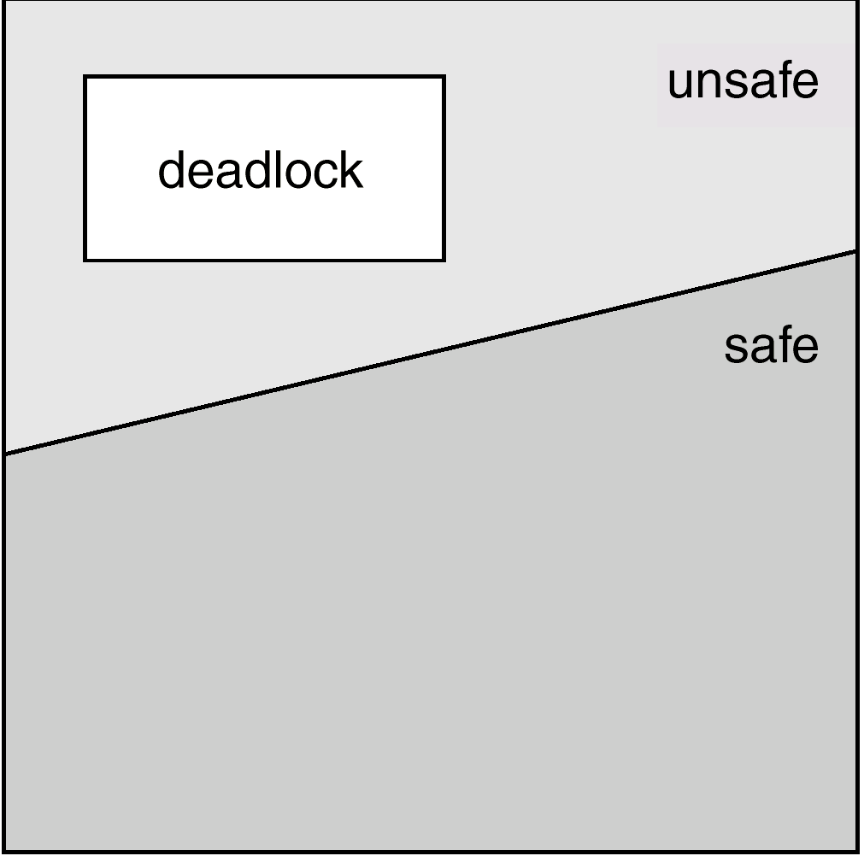
Safe, Unsafe , Deadlock State

Slide 79
Banker’s Algorithm
Handles multiple instances of resources types that the resource-allocation graph algorithm can not
Each process must a priori claim maximum use.
When a process requests a resource it may have to wait.
When a process gets all its resources it must return them in a finite amount of time.

Slide 80
Data Structures for the Banker’s Algorithm
Let n = number of processes, and m = number of resources types.
Available: Vector of length m. If Available [j] = k, there are k instances of resource type R_{j} available.
Max: n x m matrix. If Max [i,j] = k, then process P_{i} may request at most k instances of resource type R_{j}.
Allocation: n x m matrix. If Allocation[i,j] = k then P_{i} is currently allocated k instances of R_{j.}
Need: n x m matrix. If Need[i,j] = k, then P_{i} may need k more instances of R_{j} to complete its task. Need [i,j] = Max[i,j] – Allocation [i,j].

Slide 81
Safety Algorithm
Tells us whether or not a system is in a safe state
1. Let Work and Finish be vectors of length m and n, respectively. Initialize:
Work = Available
Finish [i] = false for i = 1,2, …, n.
2. Find an i such that both:
(a) Finish [i] = false
(b) Need_{i} ≤ Work
If no such i exists, go to step 4.
3. Work = Work + Allocation_{i} Finish[i] = true go to step 2.
4. If Finish [i] == true for all i, then the system is in a safe state.

Slide 82
Example of Banker’s Algorithm
5 processes P₀ through P₄; 3 resource types
A (10 instances), B (5 instances), and C (7 instances).
Snapshot at time T₀:
Available
A B C
3 3 2
Allocation Max Need
A B C A B C A B C
P₀ 0 1 0 7 5 3 7 4 3
P₁ 2 0 0 3 2 2 1 2 2
P₂ 3 0 2 9 0 2 6 0 0
P₃ 2 1 1 2 2 2 0 1 1
P₄ 0 0 2 4 3 3 4 3 1
The content of the matrix Need is defined to be Max – Allocation.
The system is in a safe state since the sequence < P₁, P₃, P₄, P₂, P₀> satisfies safety criteria.

Slide 83
Resource-Request Algorithm for Process P_{i}
Request = request vector for process P_{i}. If Request_{i} [j] = k then process P_{i} wants k instances of resource type R_{j.}
1. If Request_{i} ≤ Need_{i} go to step 2. Otherwise, raise error condition, since process has exceeded its maximum claim.
2. If Request_{i} ≤ Available, go to step 3. Otherwise P_{i} must wait, since resources are not available.
3. Pretend to allocate requested resources to P_{i} by modifying the state as follows:
Available = Available = Request;
Allocation_{i} = Allocation_{i} + Request;
Need_{i} = Need_{i} – Request_{i};
If safe ⇒ the resources are allocated to P_{i}.
If unsafe ⇒ P_{i} must wait, and the old resource-allocation state is restored

Slide 84
Example P₁ Requests (1,0,2)
Check that Request₁ ≤ Available (that is, (1,0,2) ≤ (3,3,2) ⇒ true. Pretend request fulfilled and arrive at this new state:
Available
A B C
2 3 0
Allocation Need
A B C A B C
P₀ 0 1 0 7 4 3
P₁ 3 0 2 0 2 0
P₂ 3 0 2 6 0 0
P₃ 2 1 1 0 1 1
P₄ 0 0 2 4 3 1
Executing safety algorithm shows that sequence <P₁, P₃, P₄, P₀, P₂> satisfies safety requirement. Request₁ can be granted
Can request for (3,3,0) by P₄ be granted? Request not ≤ Available
Can request for (0,2,0) by P₀ be granted? Available reduced to <2,1,0> and no process can continue

Slide 85
Deadlock Detection
Allow system to enter deadlock state
Detection algorithm
Recovery scheme

Slide 86
Single Instance of Each Resource Type
Maintain wait-for graph
Nodes are processes.
P_{i} → P_{j} if P_{i} is waiting for P_{j}.
Periodically invoke an algorithm that searches for a cycle in the graph.
An algorithm to detect a cycle in a graph requires an order of n² operations, where n is the number of vertices in the graph.

Slide 87
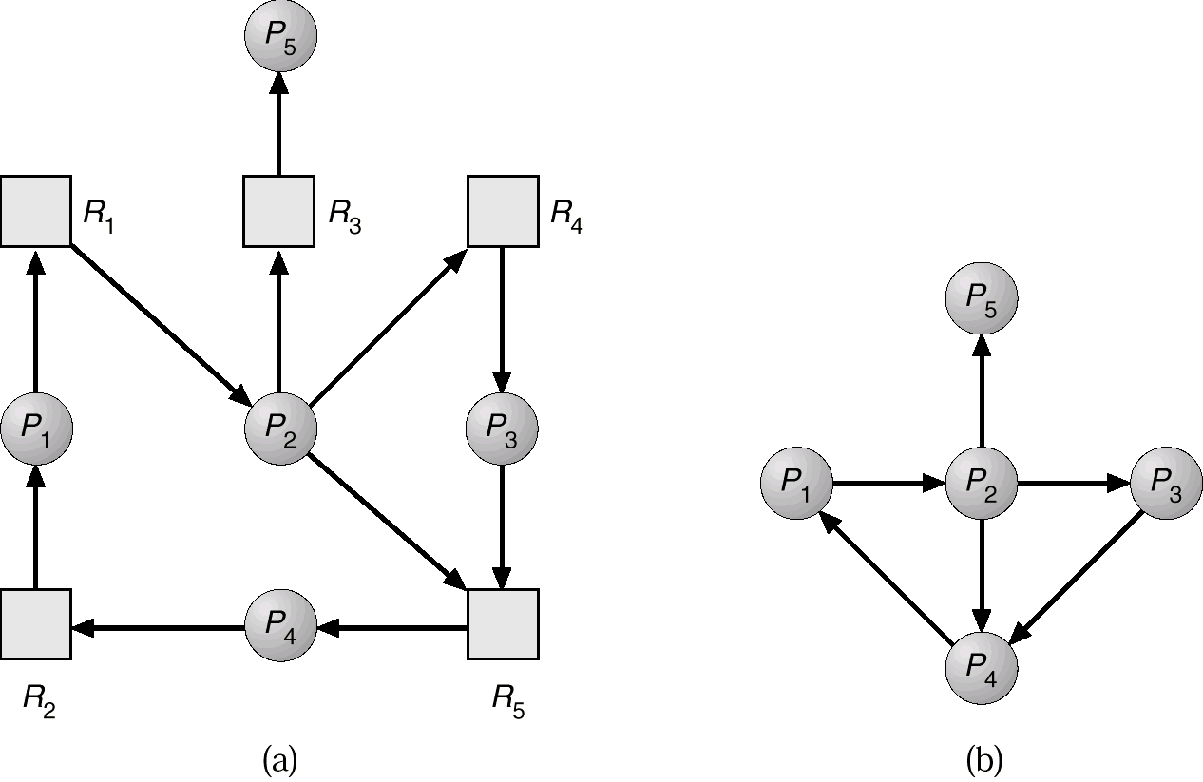
Resource-Allocation Graph and Wait-for Graph
Resource-Allocation Graph
Corresponding wait-for graph

Slide 88
Several Instances of a Resource Type
Available: A vector of length m indicates the number of available resources of each type.
Allocation: An n x m matrix defines the number of resources of each type currently allocated to each process.
Request: An n x m matrix indicates the current request of each process. If Request [i_{j}] = k, then process P_{i} is requesting k more instances of resource type. R_{j}.

Slide 89
Detection Algorithm
1. Let Work and Finish be vectors of length m and n, respectively Initialize:
(a) Work = Available
(b) For i = 1,2, …, n, if Allocation_{i} ≠ 0, then Finish[i] = false;otherwise, Finish[i] = true.
2. Find an index i such that both:
(a) Finish[i] == false
(b) Request_{i} ≤ Work If no such i exists, go to step 4.
3. Work = Work + Allocation_{i} Finish[i] = true go to step 2.
4. If Finish[i] == false, for some i, 1 ≤ i ≤ n, then the system is in deadlock state. Moreover, if Finish[i] == false, then P_{i} is deadlocked.

Slide 90
Example of Detection Algorithm
Five processes P₀ through P₄; three resource types A (7 instances), B (2 instances), and C (6 instances).
Snapshot at time T₀:
Available
A B C
0 0 0
Allocation Need
A B C A B C
P₀ 0 1 0 0 0 0
P₁ 2 0 0 2 0 2
P₂ 3 0 3 0 0 0
P₃ 2 1 1 1 0 0
P₄ 0 0 2 0 0 2
Sequence <P₀, P₂, P₃, P₁, P₄> will result in Finish[i] = true for all i.

Slide 91
Example (Cont.)
P₂ requests an additional instance of type C.
Request
A B C
P₀ 0 0 0
P₁ 2 0 2
P₂ 0 0 1
P₃ 1 0 0
P₄ 0 0 2
State of system?
Can reclaim resources held by process P₀, but insufficient resources to fulfill other processes; requests.
Deadlock exists, consisting of processes P₁, P₂, P₃, and P₄.

Slide 92
Detection-Algorithm Usage
When, and how often, to invoke depends on:
How often a deadlock is likely to occur?
How many processes will need to be rolled back?
one for each disjoint cycle
If detection algorithm is invoked arbitrarily, there may be many cycles in the resource graph and so we would not be able to tell which of the many deadlocked processes “caused” the deadlock.

Slide 93
Recovery from Deadlock: Process Termination
Abort all deadlocked processes.
Abort one process at a time until the deadlock cycle is eliminated.
In which order should we choose to abort?
Priority of the process.
How long process has computed, and how much longer to completion.
Resources the process has used.
Resources process needs to complete.
How many processes will need to be terminated.
Is process interactive or batch?

Slide 94
Recovery from Deadlock: Resource Preemption
Selecting a victim – minimize cost.
Rollback – return to some safe state, restart process for that state.
Starvation – same process may always be picked as victim, include number of rollback in cost factor.

Slide 95
Combined Approach to Deadlock Handling
Combine the three basic approaches
prevention
avoidance
detection
allowing the use of the optimal approach for each of resources in the system.
Partition resources into hierarchically ordered classes.
Use most appropriate technique for handling deadlocks within each class.

Slide 96
