Slide 1
Performance Analysis and Optimization
(General guidelines; Some of this is review)
Outline:
introduction
evaluation methods
timing
space—code compression
power

Slide 2
Performance: how can we optimize performance?
Time
Space
Power
(cost)
(weight)
{development time, ease of maintenance, extensibility}

Slide 3
Methods for analyzing performance
Instruction counting
Simulation
Measurement of actual system in action

Slide 4
Some guidelines (evaluation):
1. Don’t spend a lot of time optimizing a feature which contributes little to overall system performance
Don’t use hardware-independent metrics
ex: code size: inline functions will increase code size but can make the code faster because you are avoiding function calls
Remember that “peak performance” is only a boundary value; it may not be achievable under normal conditions
Don’t use just one metric, e.g., higher clock rate—this may not tell the whole story
Don’t use “synthetic” benchmarks, use REAL benchmarks from the problem domain you are in
ex: “random” graphs are not “circuit” graphs

Slide 5
Timing

Slide 6
Arithmetic—basic algorithms
Hierarchy of time complexity:
increment / decrement
addition / subtraction
multiplication increasing execution time
division / square root
other operations
can often trade off time for space
Example: addition of 2 16-bit numbers
carry-ripple adder:
time - 31 gate delays
space - 16 full adders
carry lookahead adder (4-bit units):
time – 8 gate delays
space – 4 4-bit CLA units—more gates, routing

Slide 7
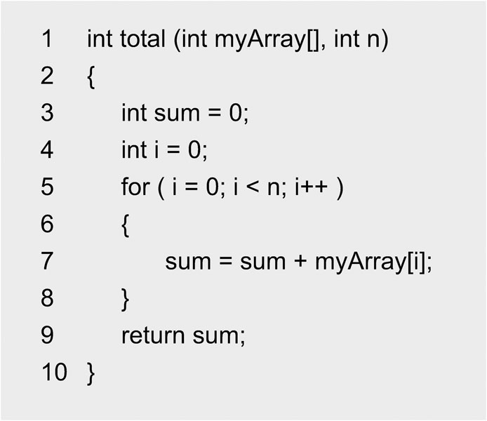
fig_14_00
Example: summing array elements—linear in size of array
fig_14_00

Slide 8
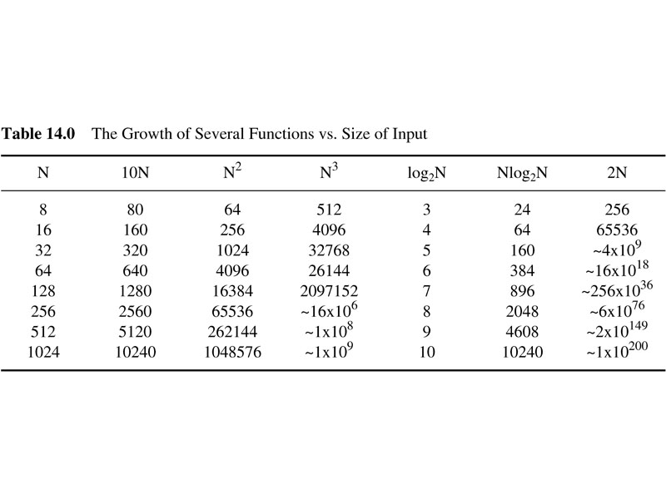
table_14_00
How to analyze performance and
Do optimizations
table_14_00

Slide 9
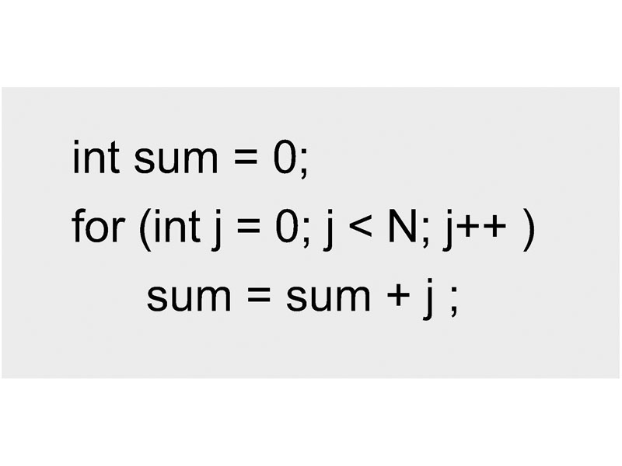
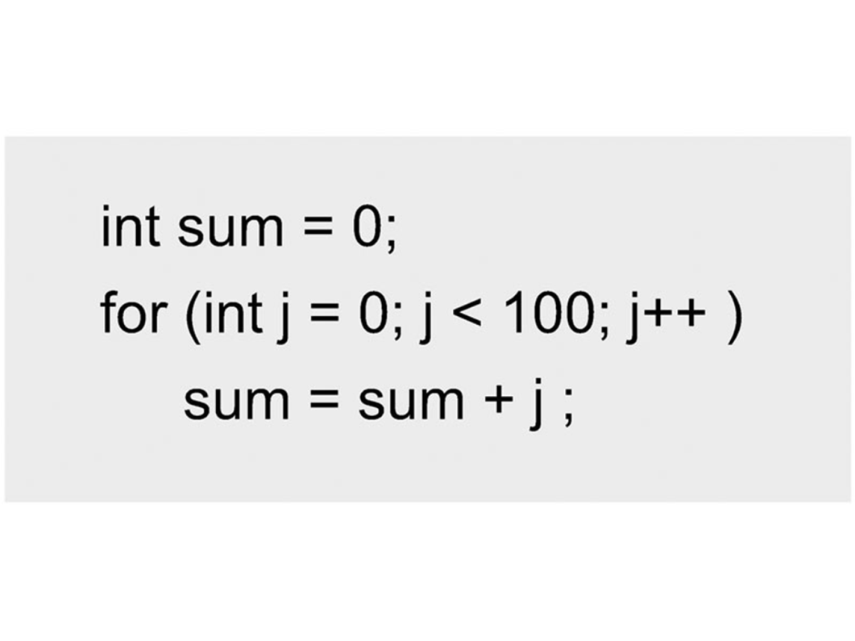
fig_14_02
Time complexity: loops--examples
Execution time proportional to N
Execution time proportional to 100—easier to analyze time but not so flexible
fig_14_02

Slide 10
Common data structures (not dynamic):
Array:
O(n) [move]:
Insert / delete at beginning
Insert / delete at end
Insert / delete in middle
O(1):
Access at beginning
Access at middle
Access at end

Slide 11
Common data structures (not dynamic):
Linked list:
O(1):
Insert / delete at beginning
access at beginning
O(n):
insert / delete at end (or O(1) if extra pointer)
insert / delete in middle
Access at middle
Access at end (or O(1) if extra pointer)

Slide 12
fig_14_09
Flow of control:
1—what is addressing mode? How long does it take to access a variable?
Common modes, relative times:
Immediate < register < direct < indirect < double indirect …
Must also consider cache and virtual memory overheads
2—standard control flows: how much time is required?
sequential
loops / conditionals
function calls: context switch
(e.g., is overhead of recursion justified?)
co-routines: e.g., 2 subfunctions operating in turn,
controlled by a “manager” function
interrupts: similar to function call, no variables passed

Slide 13
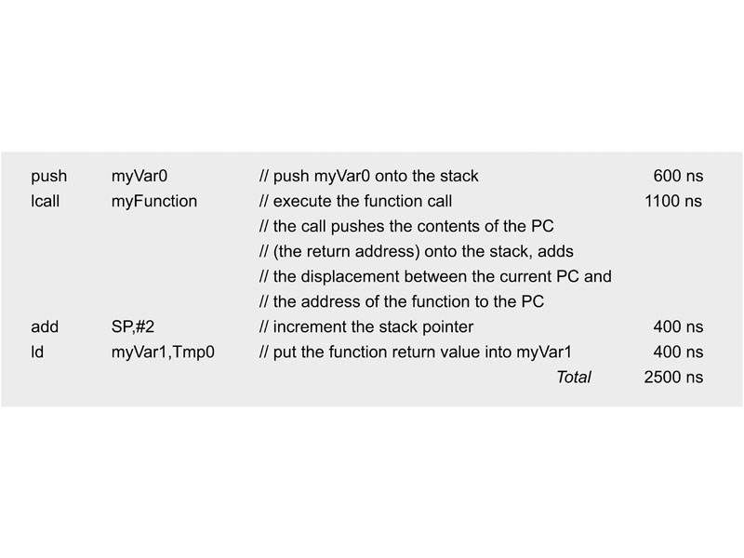
fig_14_21
Example: function call--what happens at machine level:
fig_14_21

Slide 14
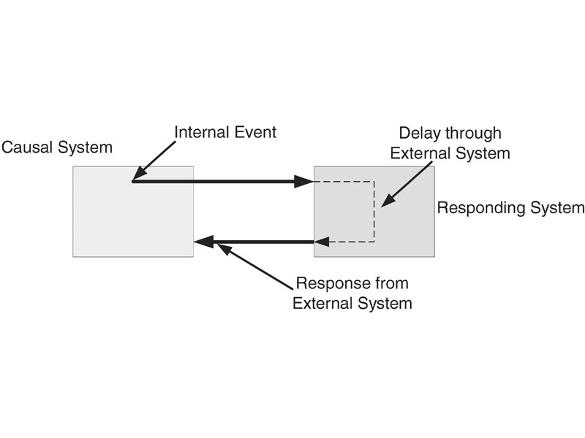
fig_14_26
Response time—2 systems
fig_14_26

Slide 15
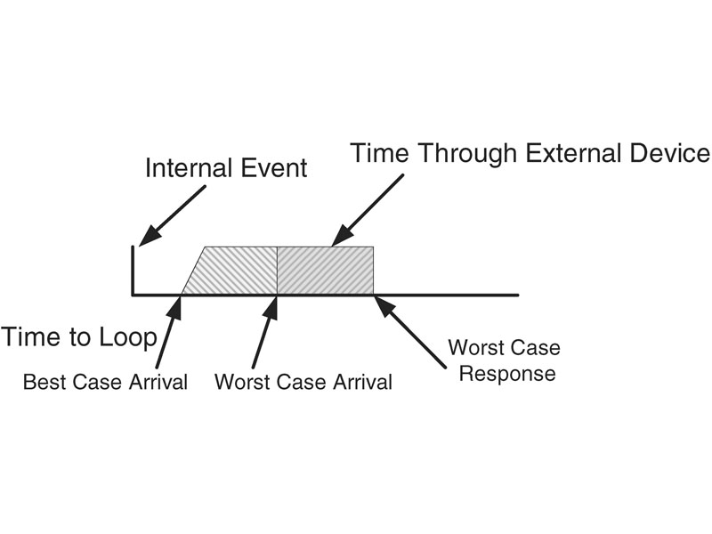
fig_14_27
Best and worst case times
fig_14_27

Slide 16
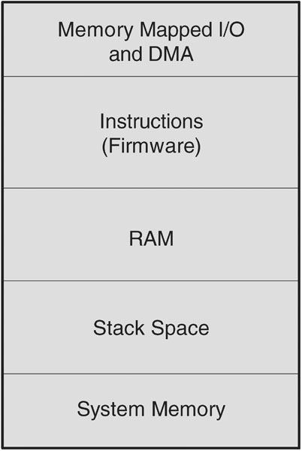
fig_14_29
Memory: hierarchy / response times
fig_14_29

Slide 17
Some guidelines (implementation):
Use lookup tables or combinational logic (for multiplication, e.g.)
Considering using shifts for mathematical calculations
Study compiler optimization techniques
Optimize loops
example: loop unrolling
example:
for (j=0; j<x+3;j++) → endVar = x+3; for (j=0; j< endVar; j++)
example: can you replace nested loops by one loop on a multidimensional array?
5. use case instead of multiple if-else statements

Slide 18
Some guidelines (implementation-continued):
Use registers and caching
Optimize the most frequently used code paths and code blocks
Know when to choose recursion versus iteration
Use macros and inline functions where appropriate

Slide 19
Implementation of bitmask based code compression algorithm on MSP430 microcontroller (excerpts)
Spcae--Code compression
Lijo John

Slide 20
Motivation
Embedded systems:
Real-time performance at a low cost
Compact in size
Minimal power consumption
Embedded systems memory:
Major design constraint
Impacts
Cost
Size
Power Consumption
Chip area

Slide 21
Code compression
Static Encoding
(Offline)
Application Program
(Binary)
Compression
Algorithm
Dynamic Decoding
(Online)
Processor
(Fetch and Execute)
Compressed Code
(Memory)
Decompression
Engine

Slide 22
Decompression Engine (DCE)
Two options:
Pre-cache design
Between memory and cache
Post-cache design
Between cache and processor
Cache holds compressed data
Reduced bus bandwidth and higher cache hits
Main
Memory
Pre-Cache
DCE
Post-Cache
DCE
D-Cache
Processor
D-Cache
Bus
Bus

Slide 23
Compression Ratio
Compression ratio
Smaller compression ratio is better

Slide 24
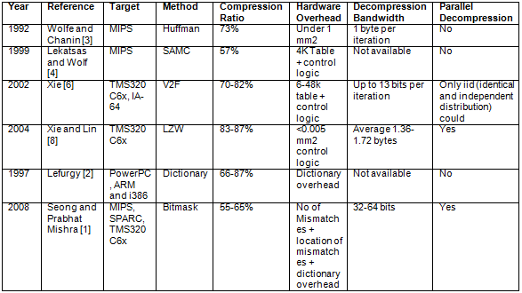
Summary of code compression algorithms
Reference numbers—see thesis

Slide 25
Compression Techniques
Dictionary based approach
Good compression ratio
Fast decompression scheme
Hamming distance based approach
Limited: profitable only up to 3 bit mismatches
Bitmask based approach
Uses bitmasks to maximize matching patterns
Improves compression ratio even further than dictionary based approach

Slide 26
Traditional dictionary-based code compression
Format for Uncompressed Code (32 Bit Code) Format for Compressed Code
Decision
(1 Bit)
Uncompressed Data
(32 Bits)
Decision
(1 Bit)
Dictionary Index
Original code size = 80 bits
Compressed code size = 62 bits
Dictionary size = 16 bits
Compression ratio = (62+16)/80
= 97.5%
Original Program
Compressed Program
Dictionary
0000 0000
1000 0010
0000 0010
0100 0010
0100 1110
0101 0010
0000 1100
0100 0010
1100 0000
0000 0000
0 0
1 1000 0010
1 0000 0010
0 1
1 0100 1110
1 0101 0010
1 0000 1100
0 1
1 1100 0000
0 0
Index | Entry
0 | 0000 0000
1 | 0100 0010
0 – Compressed
1 – Not Compressed

Slide 27
Mismatch based code compression (also dictionary)
Format for Uncompressed Code Format for Compressed Code
Decision
(1 Bit)
Uncompressed Data
(32 Bits)
Decision
(1 Bit)
# of Bit
Changes
Location
(5 Bits)
… …
Location
(5 Bits)
Dictionary
Index
Original Program
Compressed Program
Dictionary
Original code size = 80 bits
Compressed code size = 60 bits
Dictionary size = 16 bits
Compression ratio = 95%
0000 0000
1000 0010
0000 0010
0100 0010
0100 1110
0101 0010
0000 1100
0100 0010
1100 0000
0000 0000
0 1 0
1 1000 0010
0 0 110 0
0 1 1
1 0100 1110
0 0 001 0
1 0000 1100
0 1 1
1 1100 0000
0 1 0
Index | Entry
0 | 0000 0000
1 | 0100 0010
Mismatch Position
0 – Mismatch
1 – No Action
0 – Compressed
1 – Not Compressed

Slide 28
Bitmask Technique
Generate repeating patterns aggressively
Traditional dictionary and mismatch based techniques are inefficient!
XOR operation: simple and fast
0000 0000 0010 1101
11
In Dictionary
0000 0000 0010 0001
0000 0000 0011 0001
0001
1111 0100 0010 0001
111101

Slide 29
Bitmask encoding
32-bit instructions
Format for uncompressed code
Format for compressed code
Decision
(1 Bit)
Uncompressed Data
(32 Bits)
Decision
(1 Bit)
Mask
(1 Bit)
…
Dictionary
Index
Mask
Type
Location
Mask
Pattern
Mask
Type
Location
Mask
Pattern

Slide 30
Bitmask based code compression
Bit Mask Position
Bit Mask Value
Original Program
Compressed Program
Dictionary
Original code size = 80 bits
Compressed code size = 54 bits
Dictionary size = 16 bits
Compression ratio = (54+16)/80
= 87.5%
0000 0000
1000 0010
0000 0010
0100 0010
0100 1110
0101 0010
0000 1100
0100 0010
1100 0000
0000 0000
0 1 0
0 0 00 11 1
0 0 11 10 0
0 1 1
0 0 10 11 1
0 0 01 01 1
0 0 10 11 0
0 1 1
0 0 00 11 0
0 1 0
Index | Entry
0 | 0000 0000
1 | 0100 0010
0 – Bit Mask Used
1 – No Bit Mask Used
0 – Compressed
1 – Not Compressed

Slide 31
Compression algorithm
Algorithm: Bitmask based code compression
Input: Original code (binary) divided into 16-bit vectors
Output: Compressed code and dictionary
Begin
Step1: Create the frequency distribution of the 16-bit vectors
Step 2: Create the dictionary based on Step 1
Step 3: Compress each 16-bit vector using bitmask
Step 4: Handle and adjust branch targets
return Compressed code and dictionary
End

Slide 32
Branch targets
Approach for handling branch targets
Map the branch target addresses in the original code onto new target addresses in the compressed code
Fast retrieval of the new target address

Slide 33
Decompression core

Slide 34
Evaluation: Target Architecture
Texas Instrument’s 16-bit MSP430 microcontroller
Designed for a wide range of low power and portable applications
Applications include metering devices, portable medical devices, data logging and wireless communications, capacitive touch-sense IOs, energy harvesting, motor control and security and safety devices
Compression not implemented for this processor previously

Slide 35
Code Outline

Slide 36
Experimental setup
Code developed in C++ and compiled using gcc compiler
Collected sample code programs for MSP430 microcontroller from TI website (website address)
Compiled programs using TI Code Composer Studio v4.0
Implemented the bitmask based code compression algorithm on the binary files generated after compilation

Slide 37
Experimental setup cont.
In our experiments, we implemented three test cases
Test case 1: Applied a 2-bit mask
Test case 2: Applied a 4-bit mask
Test case 3: Applied a 8-bit mask
We computed the compression ratio for all three test cases
20 programs, 5 omitted because they were very similar to other programs

Slide 38
Sample code programs

Slide 39
Experimental results
Achieved a compression ratio of 62 -76%
Max
Min
(from [1])

Slide 40
Experimental results cont.
Compression ratio for ADC10_ex1
For code size below 10000 bytes

Slide 41
Experimental results cont.
Compression ratio for crc_ex1_DCOSetup
For code size above 10000 bytes

Slide 42
Result summary

Slide 43
Result summary cont.

Slide 44
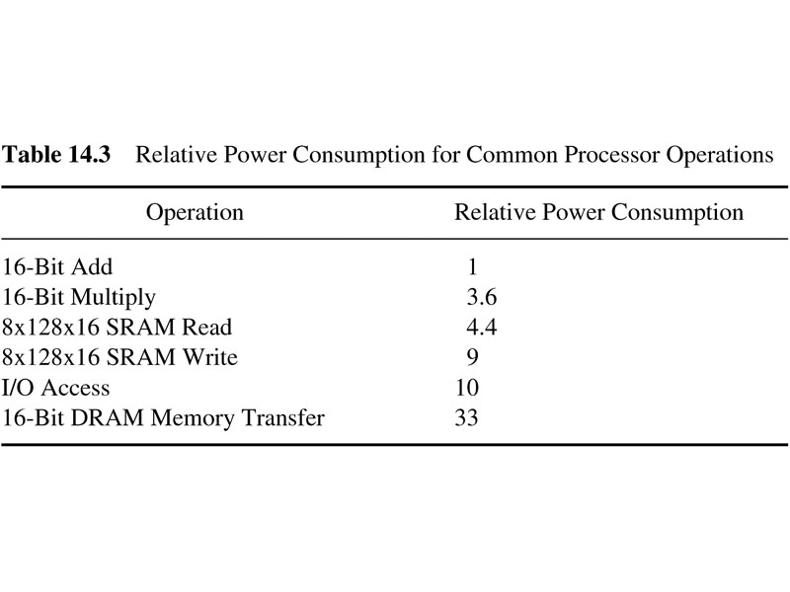
table_14_03
Power:
Power usage for some common operations:
table_14_03

Slide 45
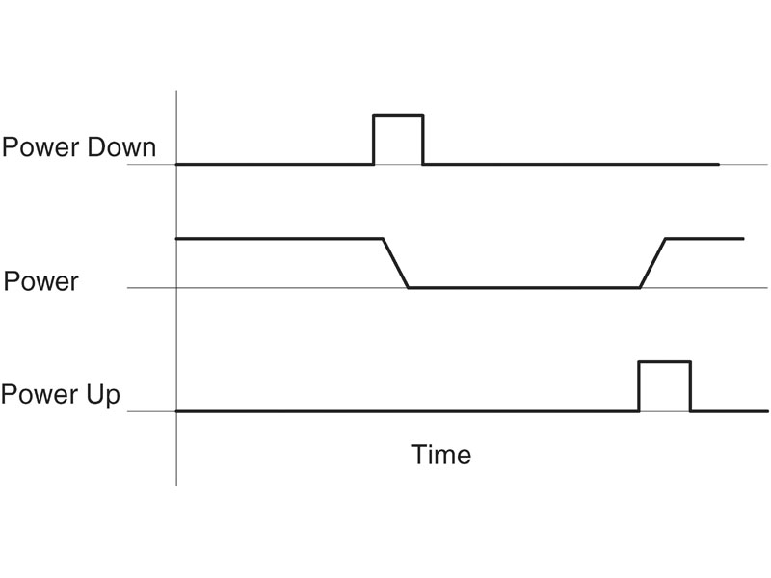
fig_14_30
Power—sophisticated management possible
fig_14_30

Slide 46
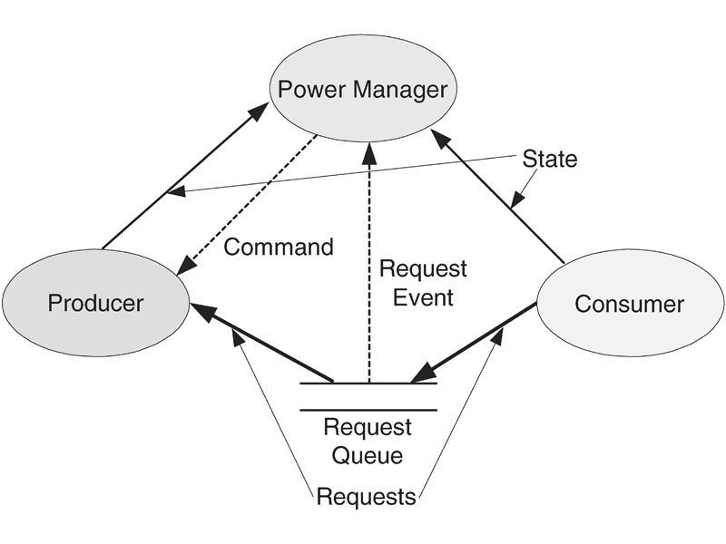
fig_14_31
Using a power manager
fig_14_31

Slide 47
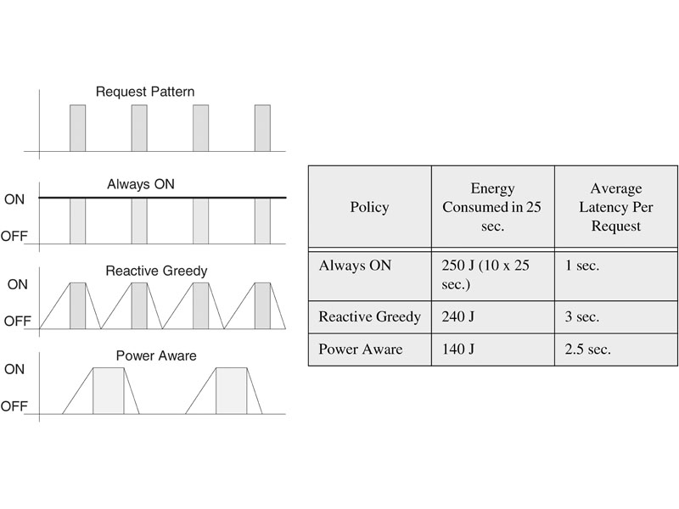
fig_14_32
Power management schemes
fig_14_32

Slide 48
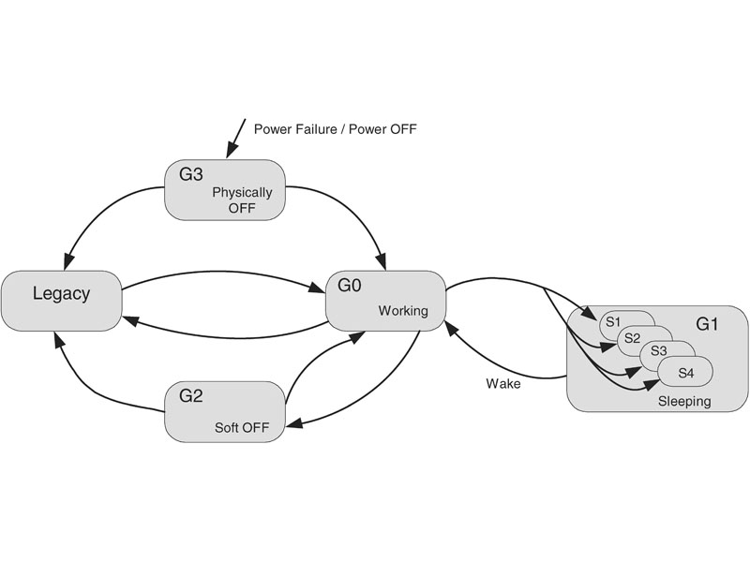
fig_14_33
Standard power modes
fig_14_33

