Slide 1
Computer Arithmetic
Integers: signed / unsigned (can overflow)
Fixed point (can overflow)
Floating point (can overflow, underflow)
(Boolean / Character)
Note: most embedded systems deal with physical input and output (medical data, mechanical quantities, temperature, concentration of a material in a mixture, etc.)
Data is typically analog and so has fractional part and a measured precision (or error range). Typically analog data will be converted to digital form for processing and then digital results are converted back to analog form.
Fixed point representation is convenient and efficient if the ranges for data / results / errors are easily represented in this form. It is well-suited to FPGA implementation.

Slide 2
fig_01_09
Numeric data
Range is always limited. For fixed point representation, number of digits of resolution is size of fractional part.
Example: in 4 numeric bits:
Number of bits in fraction range
0 (integer) 0-15
1: xxx.x 0-7.5
(fractions 0, ½)
2: xx.xx 0-3.75
(fractions, 0, ¼, ½, ¾)
3: x.xxx 0-1.875
(fractions, 0, 1/8, ¼, 3/8, ½, 5/8, ¾, 7/8)

Slide 3
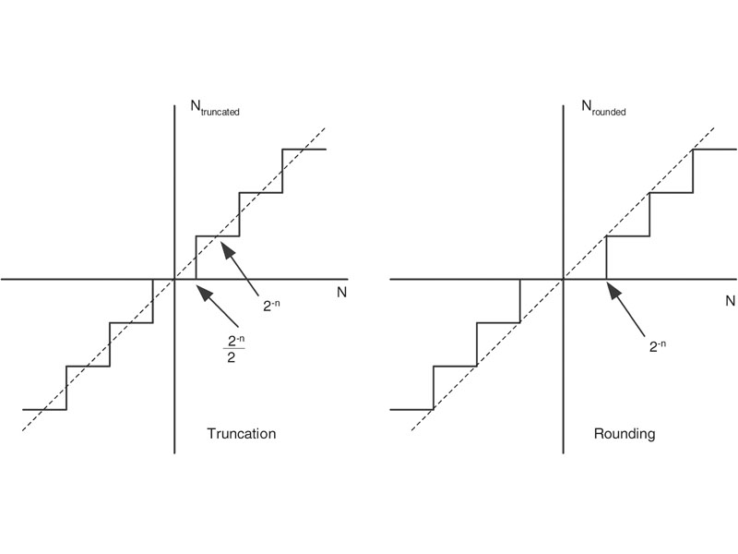
fig_01_09
Floating point errors: three sources
Measurement error (input);
Conversion error (input / output)
Overflow or underflow
Most base 10 fractions cannot be represented exactly in binary:
Example: how to represent 2.x in 4 bits, with 2 bits of resolution?
Choices: 2.0, 2.25, 2.5, 2.75, 3.0
2.1 → 2.0 or 2.25
2.2 → 2.0 or 2.25
2.3 → 2.0 or 2.25 or 2.5
fig_01_09
r
rounding
truncation
truncation
rounding
down
Error range for n bits of resolution:
Truncation: -2^{-n} < E_{truncation} < 0
Rounding: - ½ 2^{-n} < E_{rounding} < ½ 2^{-n}
Computation: which is easier to compute?
rounding
up

Slide 4
fig_01_09
Error propagation in arithmetic:
Examples:
Consider two numbers whose true values are N₁ and N₂
and whose values in the computing system are N_{1E} and N_{2E}
Addition: errors add: N_{1E} = N₁ + E₁
N_{2E} = N₂ + E₂
N_{1E} + N_{2E} = (N₁ + E₁) + (N₂ + E₂)
= N₁ + N₂ + E₁ + E₂
Multiplication: error :
N_{1E} * N_{2E} = (N₁ + E₁) * (N₁ + E₂)
= (N₁N₂) + (N₂ * E₁ + N₁ * E₂) + (E₁ * E₂)
term 1 term 2
Note that if term 2 is neglected then error depends on size of N₁ and N₂

Slide 5
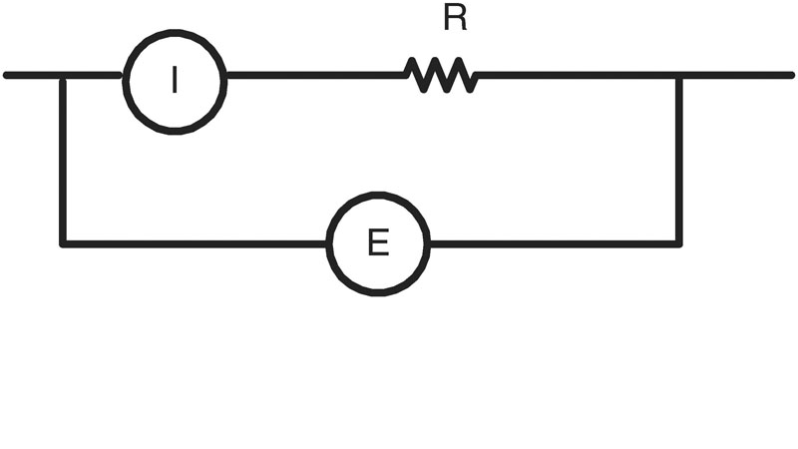
fig_01_10
Another example (pp. 11-12 of Peckol): measuring power dissipated in resistor R in the following circuit:
Suppose E = 100 VDC +/- 1%, I = 10A +/- 1%, R = 10 ohms +/- 1%.
3 methods of calculating power dissipated, neglecting lower order error terms:
a. E1 = (100V +/- 1%) * (10A +/- 1%) = 998.9 → 1001.1
b. I²R = (10A +/- 1%) * (10A +/- 1%) * (10 ohms +/- 1%) = 997 → 1003
c. E3 = (100 V +/- 1%)*(100 V +/- 1%) / (10 ohms +/- 1%) = 908.9 → 1111.3
Which should we use?
“optimistic”: a
“middle-of-the-road”: average of a,b,c
“safest”: c
fig_01_10

Slide 6
ALU:
What are the basic functions to include?
What implementation of each function will optimize
Speed?
Size?
Power usage?
Possible list:
Conversions analog ←→ digital
Conversions decimal ←→ binary
Shifts: left/right; logical/arithmetic; linear/circular
Addition / subtraction /comparison
Multiplication
Division / square root
Function approximations (trig, exp, log, e.g.)
Which are the truly “fundamental” operations?

Slide 7
ALU:
What is our internal representation for numbers?
How will we do “arithmetic”?
Integer: we probably want some integer arithmetic, we will need it for looping, for example
Fixed point: can we use “integer” operations?
Ex: assume each number is stored in 1 byte, two bits are the
“fraction”, and assume we have integer arithmetic implemented
What happens to the fractional part if we
Add / subtract
Multiply
Divide

Slide 8
ALU:
What about (normalized) floating point numbers?
Ex: -1.01 x 2⁴, +1.011 x 2⁻⁷
What ALU operations are required?
Operation Preprocess Operate Postprocess
Add / subtract
Multiply
Divide
Note that both “overflow” and “underflow” can occur for floating point numbers

Slide 9
ALU (integers):
Fundamental operation: Addition / subtraction:
Note: overflow: result can be one bit larger than inputs
What adder designs are available?
Example: O(n) adder for n-bit inputs
Small, slow: ripple carry adder (recall typical FPGA LUT):
Source: http://www.ece.msstate.edu/~reese/EE4743/vhdlcomb/sld027.htm

Slide 10
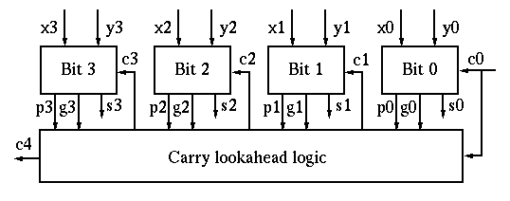
ALU:
Example: faster but more complex: “carry lookahead”
In bit i: define Pi “propagate” and Gi “generate:
Inputs Pi Gi c1 = g0 + c0p0
0 0 0 0 c2 = g1 + c1p1 = g1 + (g0 + c0p0)p1
0 1 1 0 etc.
1 1 1
Note: why is it that:
1.in theory can propagate carries as far as we want to get O(log n) time;
2.in practice we will only propagate the carry a fixed number of bits, e.g., 4.
Source: http://fourier.eng.hmc.edu/e85/lectures/arithmetic_html/node7.html

Slide 11
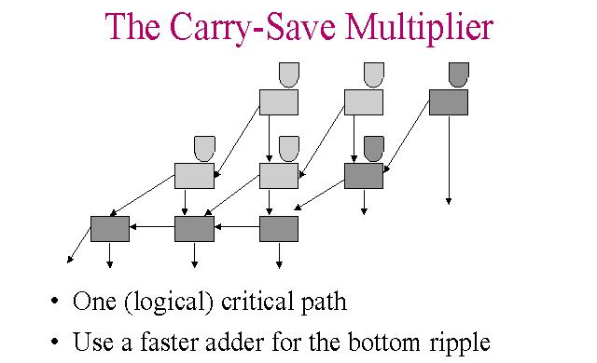
ALU (integers):
Fundamental operation: Multiplication
Product of 2 n-bit numbers can be stored in 2n bits
Simplest solution: add n times: time O(n²)
Another possible solution: “carry-save” addition: each adder computes a sum and a carry; 3 inputs generate 2 outputs; time O(n)
Inputs: Sum Carry
000 0 0
001 1 0
011 0 1
111 1 1
Source:http://www.cs.cmu.edu/afs/cs.cmu.edu/academic/class/15828-s98/lectures/0121/sld018.htm

Slide 12
ALU (integers):
Multiplication: Other commonly used techniques:
Wallace trees for arranging computations more efficiently
Booth encoding for reducing the number of steps:
example:
if we need to multiply by 15 = 1111 we can
instead multiply by 16 (which is just a shift)
and then subtract the multiplicand
(15 = 16 – 1)
typically we would do this by using digits
1, 0, -1 instead of 1, 0

Slide 13
ALU (integers):
Fundamental operation: division: X = Q*D + R, R < D (all positive)
Division, like most “inverse” problems, is more difficult than multiplication
Simplest method: multiple subtractions; dividend in a “register pair”; shift the double register left, subtract D from the left-most register if possible and shift in 1, else shift in 0; note that overflow can occur
Example: compare the result of 6/2 with the result of 18/2
R1, R2: 6/2 R1, R2: 18/2
Initial: 0000, 0110 0001, 0010
Shift R1,R2, compute lsb of quotient 0000, 1100 0010, 0100
Shift R1,R2, compute lsb of quotient 0001, 1000 0100, 1001
Shift R1,R2, compute lsb of quotient 0011, 0000 1001, 0011

Slide 14
ALU (integers):
Fundamental operation: division
Some other methods commonly used for division:
“restoring”; always subtract; if result is negative, add back in
“nonrestoring”: use digits +1, -1 for quotient. If the partial remainder is negative, the quotient digit is -1, and we add the divisor back in on the next step
SRT division: “guess” the quotient digit; use a look-up table to help choose an accurate digit
Series methods, e.g., 1/b = 1/(1 + X) = 1 – X + X² – X³ + …(Maclaurin series)
Use approximations, e.g., Newton’s method for f(X) = 1/ X - b and compute approximation X_{i+1} = X_{i} – f(X_{i})/f’(X_{i}). . This is considered a “fast” method, since it gives two digits per iteration.
Note: square root can be computed by methods similar to division since the “pencil & paper” method to find square roots is based on(X+Y)² = X² + 2XY + Y²
Example: square root of 2731: 5² = 25, so 2731 = (5*10 + Y)² = 2500 + 2*50Y + Y²
(etc.)

Slide 15
More complex functions: e^{x}, log x, sin x, cos x, ….
1. Can use series expansion (e.g., Taylor or Maclaurin series)
2. can use a fixed set of polynomials (e.g., Chebyshev polynomials) to approximate the desired function
3. Can store a table and do table look-up
4. Can use cubic polynomials
Example: (Hauser and Purdy, Embedded Systems Programming, 2003): use a genetic algorithm to find the coefficients of approximating cubic polynomials

Slide 16
Sine Function Comparison of Results (Hauser & Purdy 2003)
Method Worst Case Error
Taylor (float) 4 x 10⁻⁶
Taylor (fixed) .25
Chebyshev (float) 7 x 10⁻⁶
Chebyshev (fixed) 5 x 10⁻³
Table Lookup (fixed) 6 x 10⁻⁴
GA 3.5 x 10⁻⁵

Slide 17
ALU (floating point):
If X,Y are floating point numbers (IEEE standard format),
X = (sign bit) [1.x₁x₂x₃…..] * 2e,
Y = (sign bit) [1.y₁y₂y₃.....] * 2^{f}
addition / subtraction: shift so exponents are the same, add significant digits, shift result to normalize
Multiplication: multiply (signed) significant digits, add exponents, shift result to normalize
Division: divide (signed) significant digits, find difference of exponents, shift result to normalize

Slide 18
DSP (digital signal processing)
Typically data input / output streams must be processed in “real time” (e.g., video signals or heart rate monitors)
So “locality” of operations is important, data must be processed as it arrives
Pipelined algorithms are very useful for this type of system

