Slide 1
UML—syntax for loops, conditions

Slide 2
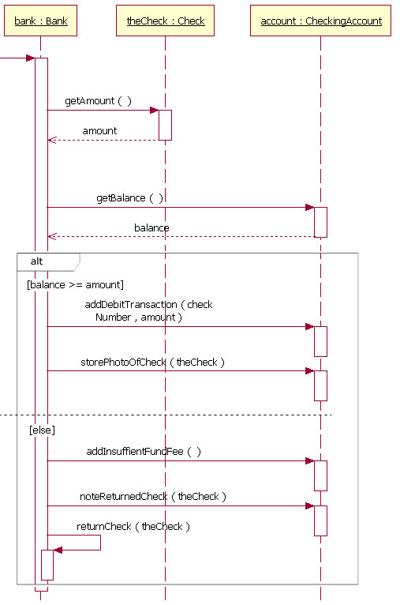
showing a branch in a UML sequence diagram: http://stackoverflow.com/questions/8114770/how-to-show-if-condition-on-a-sequence-diagram

Slide 3
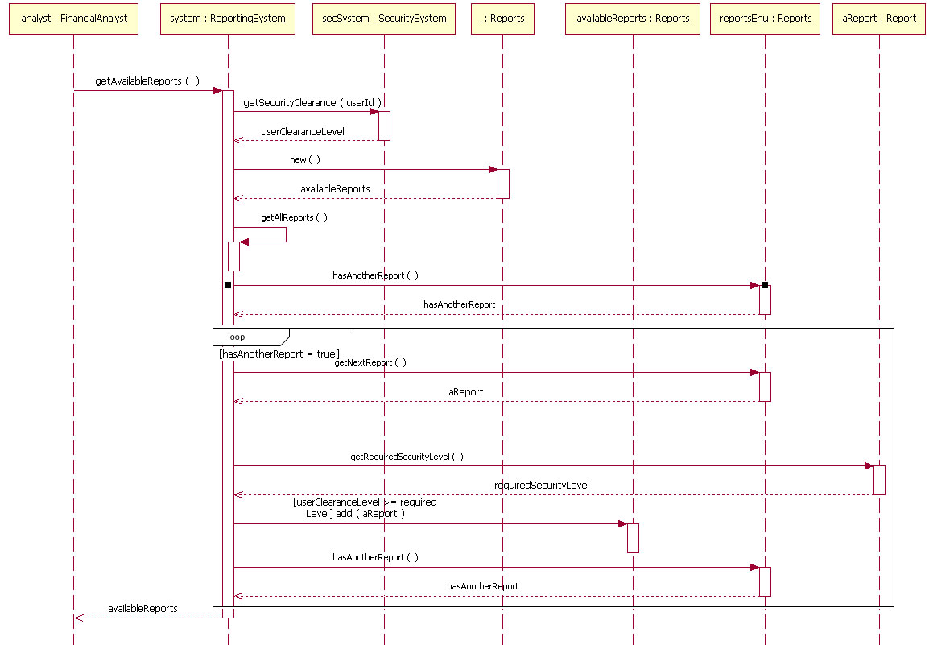
Looping in a sequence diagram: http://www.ibm.com/developerworks/rational/library/content/RationalEdge/feb04/3101_figure10.html

