Slide 1
Adding non-traditional constraints to the embedded systems design process
Indira Jayaram

Slide 2
Agenda
Goals of the project
Proposed extensions to the embedded systems design process
Design example – camera
Results – comparison of implementations
Other design examples
Conclusions and future work

Slide 3
Goals of the project
Add nontraditional system requirements to embedded systems design process
Propose extensions to object-oriented design process (UML) through stereotypes
Design example systems using the proposed method
Show how the process leads to making the most reasonable implementation choice

Slide 4
Basic design process
Object-oriented design process proposed by Bruegge and Dutoit [1]
Steps include :
Requirement elicitation
Development of UML models
Designing the system
Designing the components of the system
Implementing the components
Testing
1. Bernd Bruegge and Alan Dutoit, Object-Oriented Software Engineering Using UML, Patterns, and Java, Third Edition, Prentice Hall, 2010

Slide 5
Proposed design process
Requirement elicitation, specification
  Functional
  Nonfunctional, traditional—e.g., power usage
  Nonfunctional, nontraditional—e.g., cost
Development of UML models
Designing the system
Designing the components of the system
Implementing the components
Integrating the components
Testing

Slide 6
Camera example [2]
Requirements | Low-end camera | High-end camera
Resolution | Low (5Million Pixel) | High(12Million Pixel)
Modes | Commonly used Auto modes, no exposure compensation | All parameters changeable – aperture, shutter speed, exposure.
Storage | SD/SDHC memory | CompactFlash
Lens | AF lens | Optical zoom lens
Movie mode | Yes | No
Size | 2.5(w) ,4(h), 1.5(d) inches | 6.2(w), 5.9(h), 3.4(d) inches
Cost | Less than 150 USD | 500-1500 USD
Weight | Less than 8 oz | 30-40oz
Processing speed | Fast enough to be useful (in the range of seconds) | High, owing to many operations
.
2. Frank Vahid and Tony Givargis, Embedded System Design: A Unified Hardware/Software Introduction, John Wiley & Sons, 2002

Slide 7
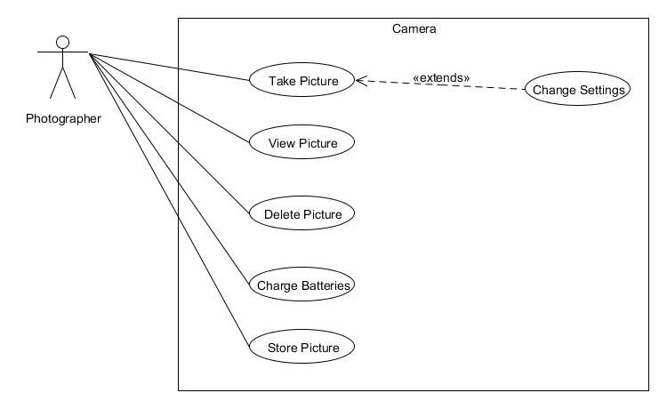
Camera example – Use case diagram

Slide 8
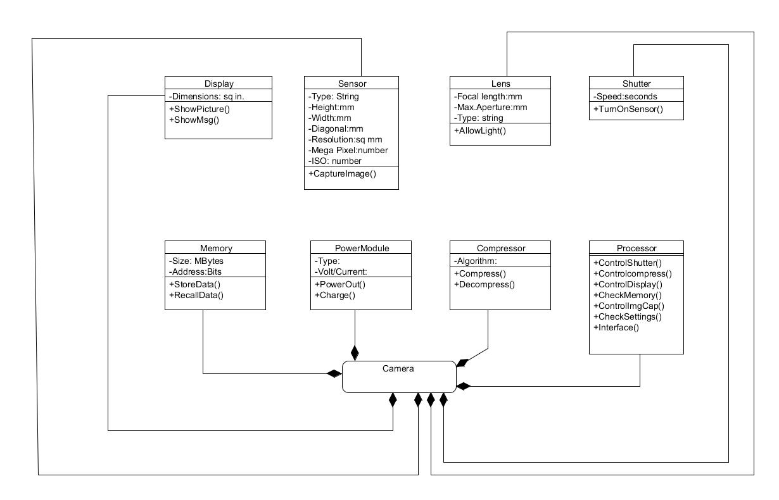
Camera example – Class diagram

Slide 9
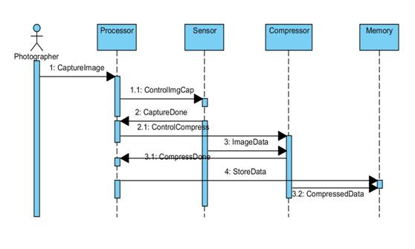
Camera example – Sequence diagram

Slide 10
Modifying basic design process
UML Lacks support to represent non-functional and non-traditional requirements:
    Solution: Add MARTE annotations [3]
Only way to see if those requirements are satisfied is trial and error:
    Add weighted constraint graphs
3. MARTE home page (Apr 26, 2012), http://www.omgwiki.org/marte

Slide 11
Proposed extensions to the design proces
Design steps by Bruegge and Dutoit | Proposed extensions | Comments
1.Elicit functional requirements | 1a. List non-traditional requirements | Ex: Size, power,cost,security,reliability, safety, controllability
2. Analyze requirements and generate specifications: Generate: Functional models Object models Dynamic models | 2a. Weight the non-traditional requirements: generate weighted-constraint graphs for the system 2b. Generate weighted-constraint graphs for different classes in the object model 2c. Annotate the object models to reflect non-traditional properties by applying MARTE’s NFP and GRM profiles 2d. Annotate the dynamic models to reflect time-based operations by applying MARTE’s Time profile 2e. Annotate the dynamic models to indicate the classes responsible for fulfilling the timing requirements | System acceptance tests should be defined during this step also.

Slide 12
Basic process | Extensions | Comments
3. Design the system : Map subsystems into components Design global control flow Identify boundary conditions Decide on the trade-offs from functionality perspective | 3’. Decide on the trade-offs with the non-traditional properties taken into consideration | System level tests should be defined during this step
4. Design the objects in the system: Reuse existing off-the shelf components Specify interfaces - Optimize |  | The non-traditional constraints will be considered during design and they have been integrated into the requirement and specification steps
5. Map the object model to the interface platform |  | Implementation level tests should be defined during this step
6. Test: Plan the tests by considering the tests that have been defined Test the units Test the integrated units Test for usability | 6a. Test the system for performance on non-traditional properties front 6b. Verify if the performance matched the requirements as specified in the weighted constraint charts
.

Slide 13
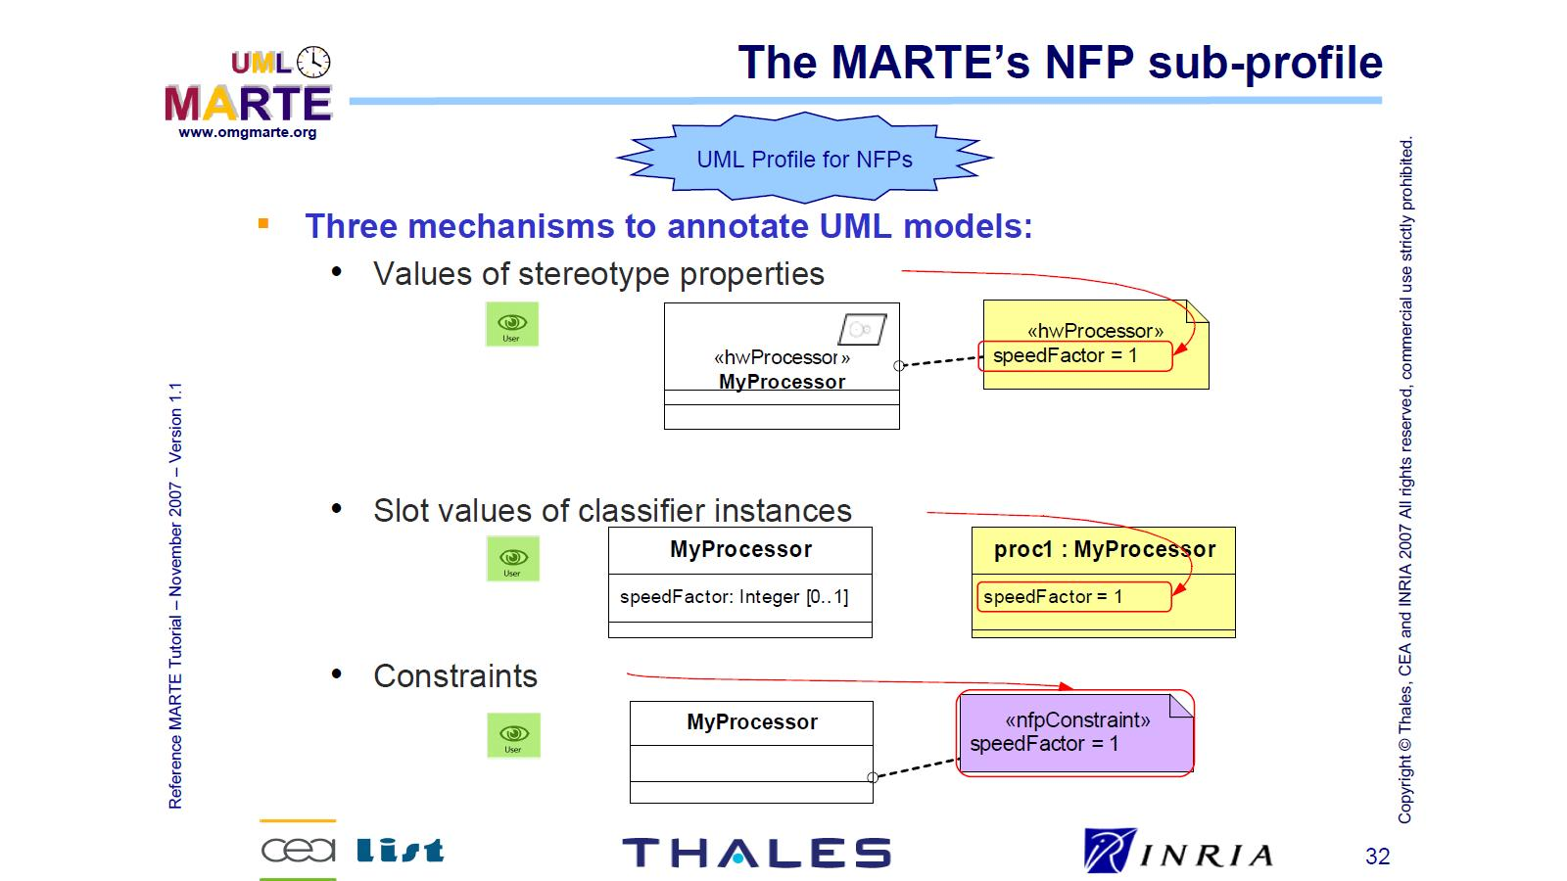
MARTE (Modeling and Analysis of Real Time and Embedded Systems) – set of UML profiles to represent NFPs [4]
4. MARTE Tutorial, http://www.omg.org/omgmarte/Tutorial.htm

Slide 14
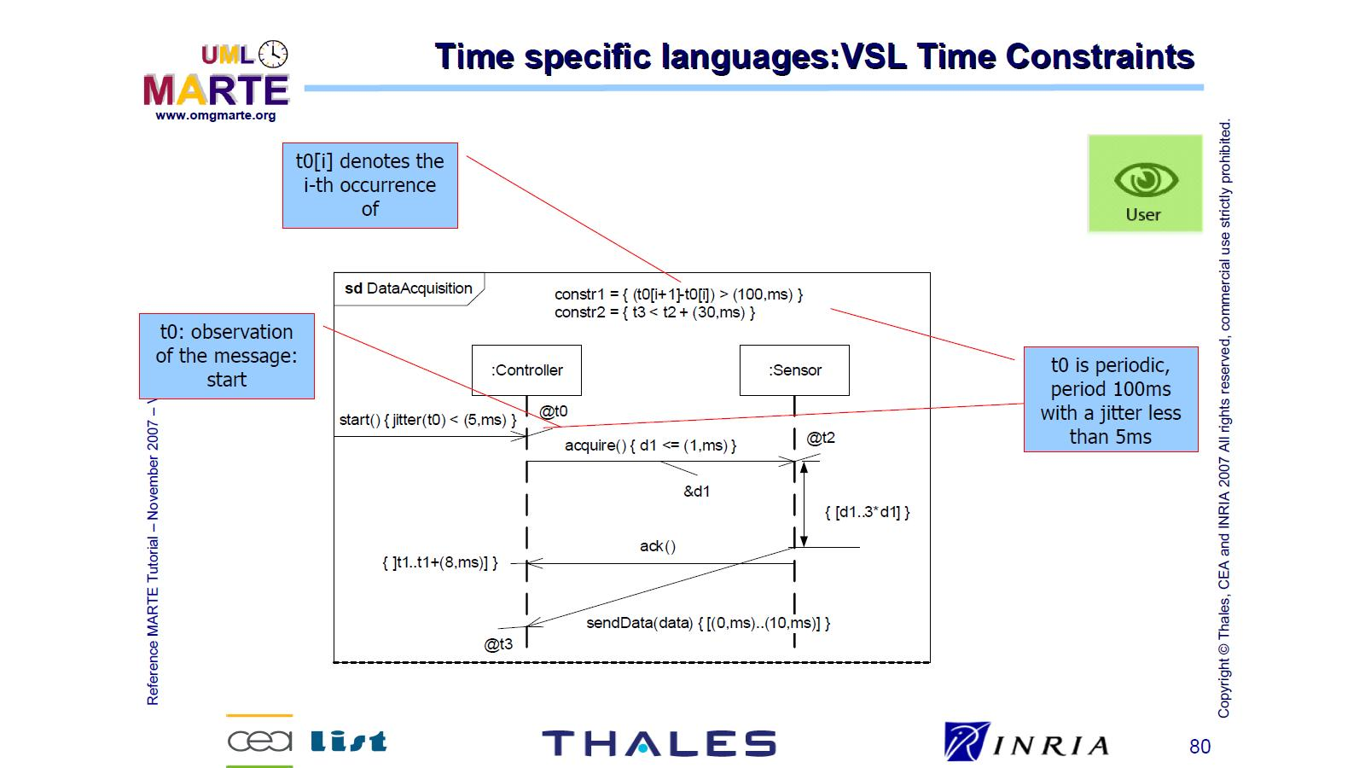
MARTE Time profile

Slide 15
Weighted constraint charts
Constraints (requirements) are weighted in the order of how crucial they are.
Weights add up to 100
Requirements-> | Req1 | Req2 | Req3 | Req4 | Req5
Weights-> | W1 | W2 | W3 | W4 | W5

Slide 16
Caveats
Weights are decided intuitively. Currently, no theoretical basis to decide.
Main purpose of using weights is to consider the relative importance of constraints rather than giving them absolute values.
For example, could equate weights to “critical”, “important”, “desirable”, “nice to have”.
Weights can be refined in an organization as the organization’s process becomes more mature.

Slide 17
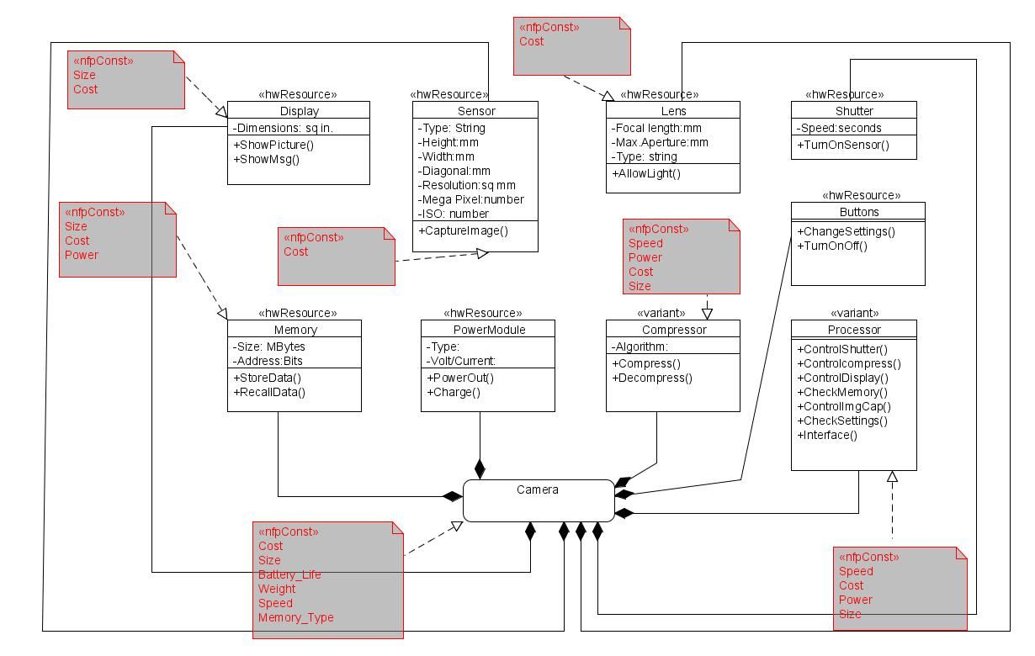
Modified camera example: applying extended design steps

Slide 18
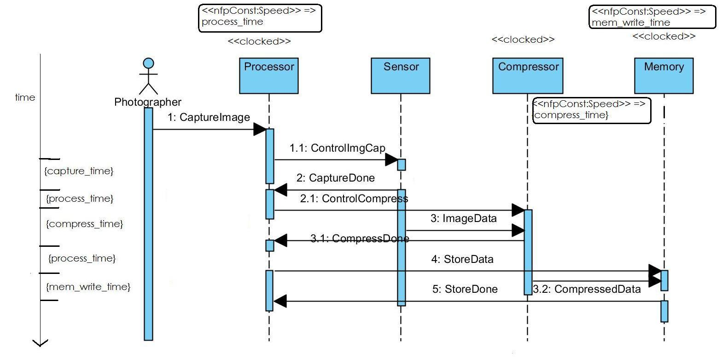
Modified camera example: applying extended design steps
Sequence diagram with time values

Slide 19
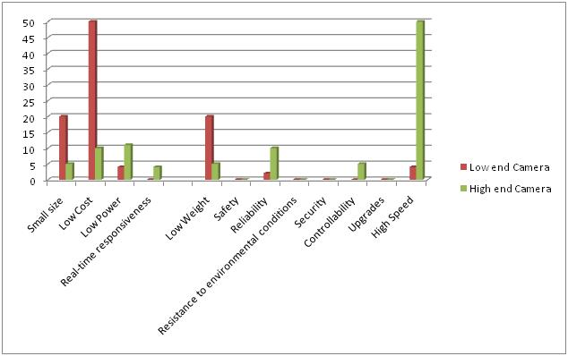
Weighted constraint charts for high-end and low-end cameras

Slide 20
Components that make up the system must be chosen in such a way that they satisfy the constraints
To see how the constraints can be met by different combinations of the components, weighted constraint charts are to be drawn for the classes (which lead to components) of the system

Slide 21
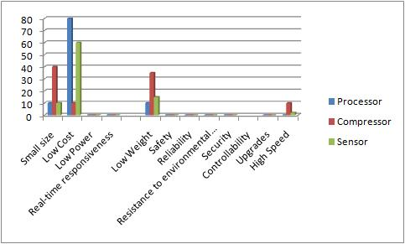
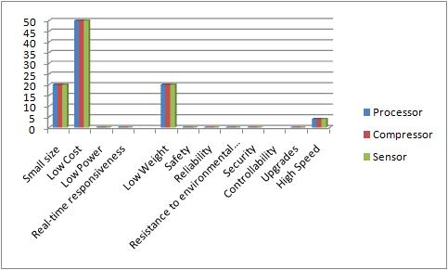
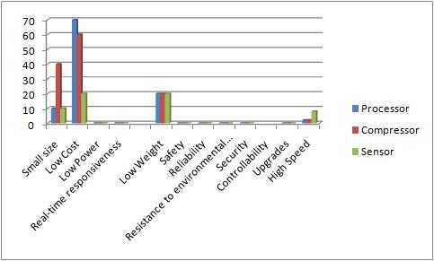
Weighted constraint charts for components of low-end camera

Slide 22
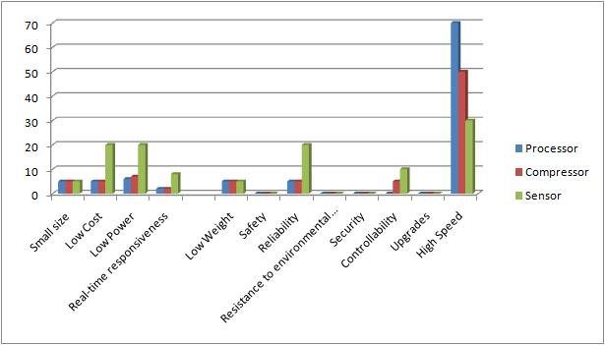
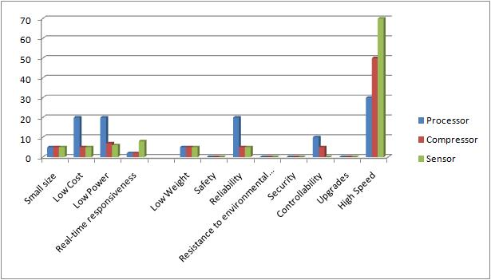
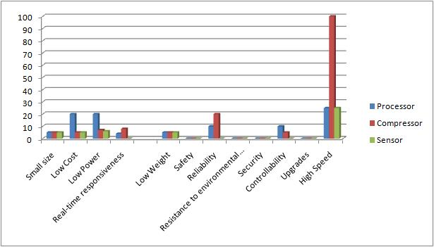
Weighted constraint charts for components of high-end camera

Slide 23
Implementation of a simple camera control system
Very low-end version. Img resolution = 64*64 pix, Processing time < 10s
Implementation platform – Altera UP3 FPGA board with NIOS soft core processor
Make use of off the shelf components with known specifications

Slide 24
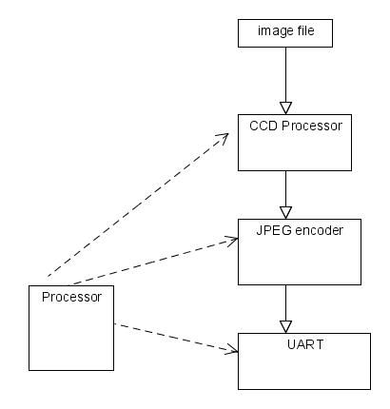
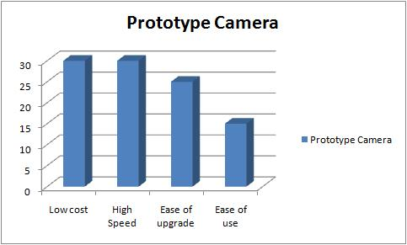
Basic Flow diagram and constraint chart

Slide 25
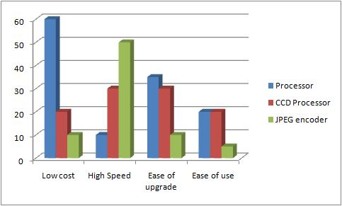
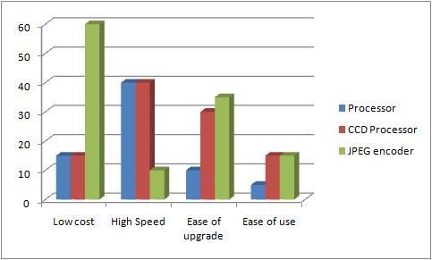
Constraint charts for components

Slide 26
Comparison of available off-the shelf components and previous implementations
Software implementation on 8051 platform [2]
Performance: 9s at 12MHz, Complexity: 98k gates
JPEG encoder hardware[5]:
Performance: 1s at 25MHz, Complexity: 10k logic
elements on Altera UP3 board
CCD processor hardware[4]:
Performance: 0.2s at 25MHz, Complexity: 8k
gates in Verilog
5. James Rosenthal, JPEG image compression using an FPGA, M.S. Thesis, EE Dept. UC Santa Barbara, 2006

Slide 27
A few possible implementations
Software implementation : Port the code available for 8051 platform to suit the NIOS core
Hardware implementation: Use the JPEG encoder hardware, CCD processor hardware and come up with hardware logic for general controls
Mixed implementation 1: Use the JPEG encoder hardware along with the software components for all other blocks
Mixed implementation 2: Use the CCD processor hardware along with software components for remaining blocks

Slide 28
Based on the constraint charts drawn previously, implementation 3 seems like the best choice:
  1st implementation barely meets time constraint
  2nd implementation barely meets cost constraint—uses 98% of chip area; if any changes are needed, a larger chip must be chosen; also ease of upgrade is very low
  3 and 4 are comparable; values for 3 are closest to values in the constraint graph

Slide 29
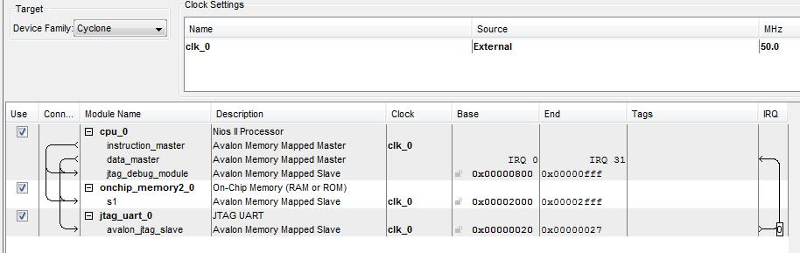
Results of implementation on UP3 board

Slide 30
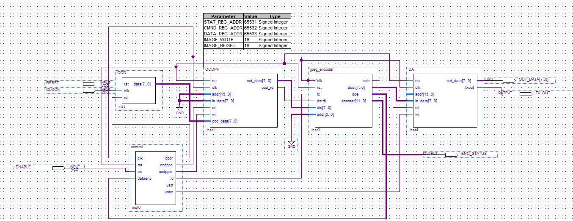
Implementation 2

Slide 31
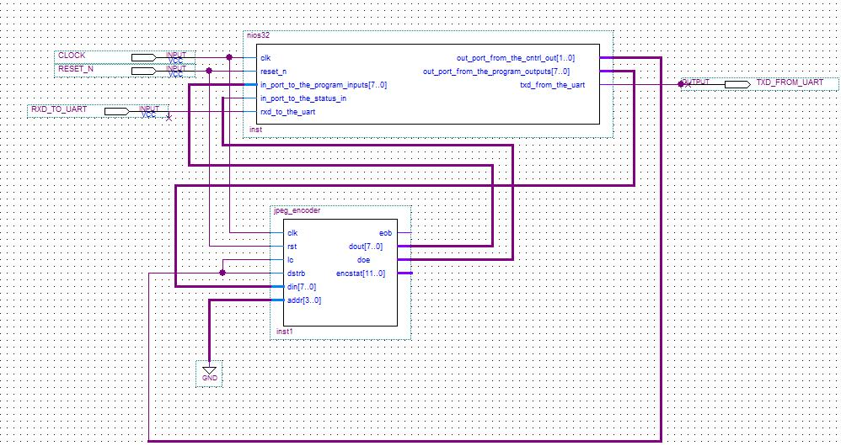
Implementation 3

Slide 32
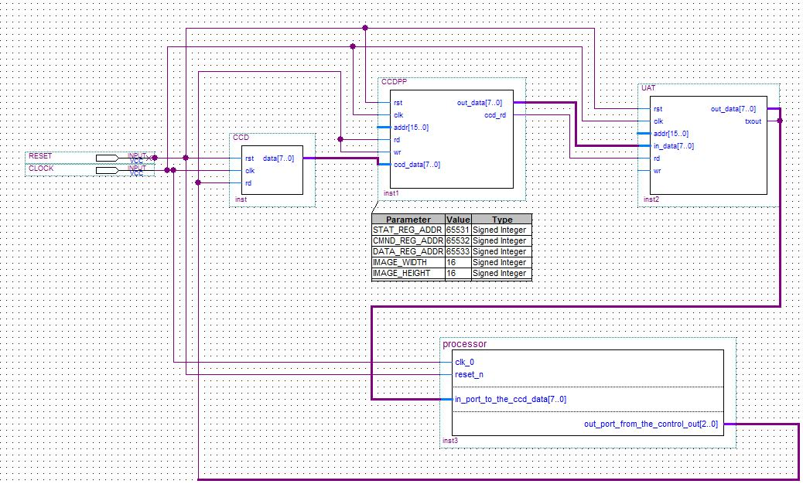
Implementation 4

Slide 33
Comparison of implementations
 | Processing time | Logic elements | Memory usage | Pin usage
Implementation 1 | 8s | 11% | 18% | 1%
Implementation 2 | 1s | 98% | 20% | 32%
Implementation 3 | 6s | 18% | 18% | 2%
Implementation 4 | 3s | 87% | 17% | 14%

Slide 34
Implementations 3 and 4 are the main contenders. A closer comparison:
Implementation 3 is better.
 | Speed | Cost | Ease of use | Upgrades
Implementation 3 | x | y | High | Very easy
Implementation 4 | 2x | 4y | Very high | Easy

Slide 35
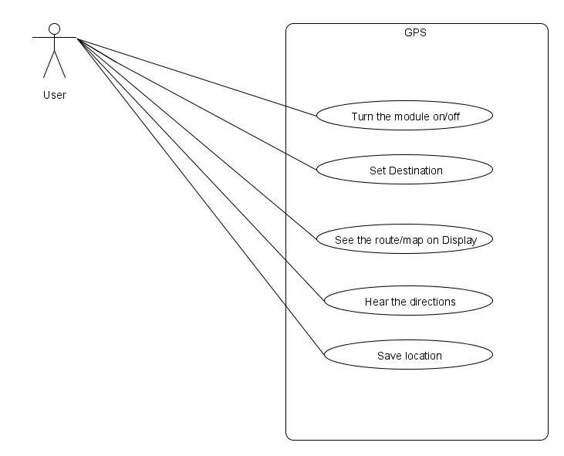
Other systems designed [6]
GPS
6. Indira Jayaram, Adding non-traditional constraints to the embedded systems design process, MS thesis, Univ. of Cincinnati, 2011.

Slide 36
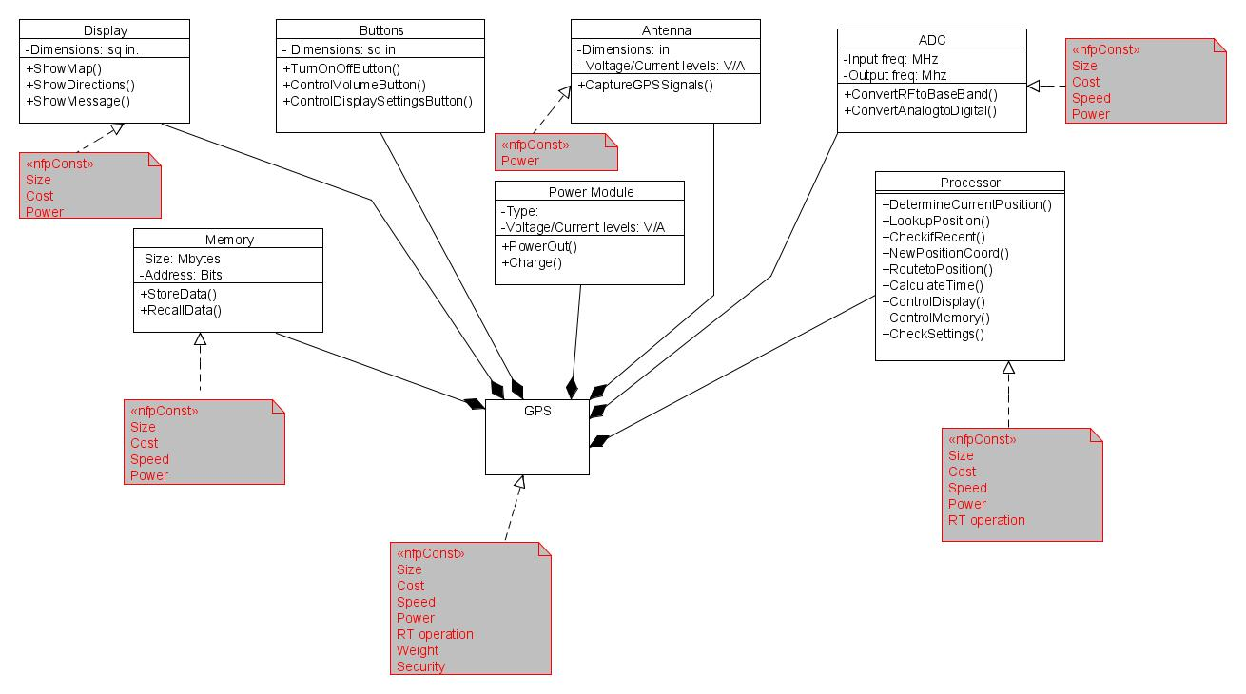
GPS

Slide 37
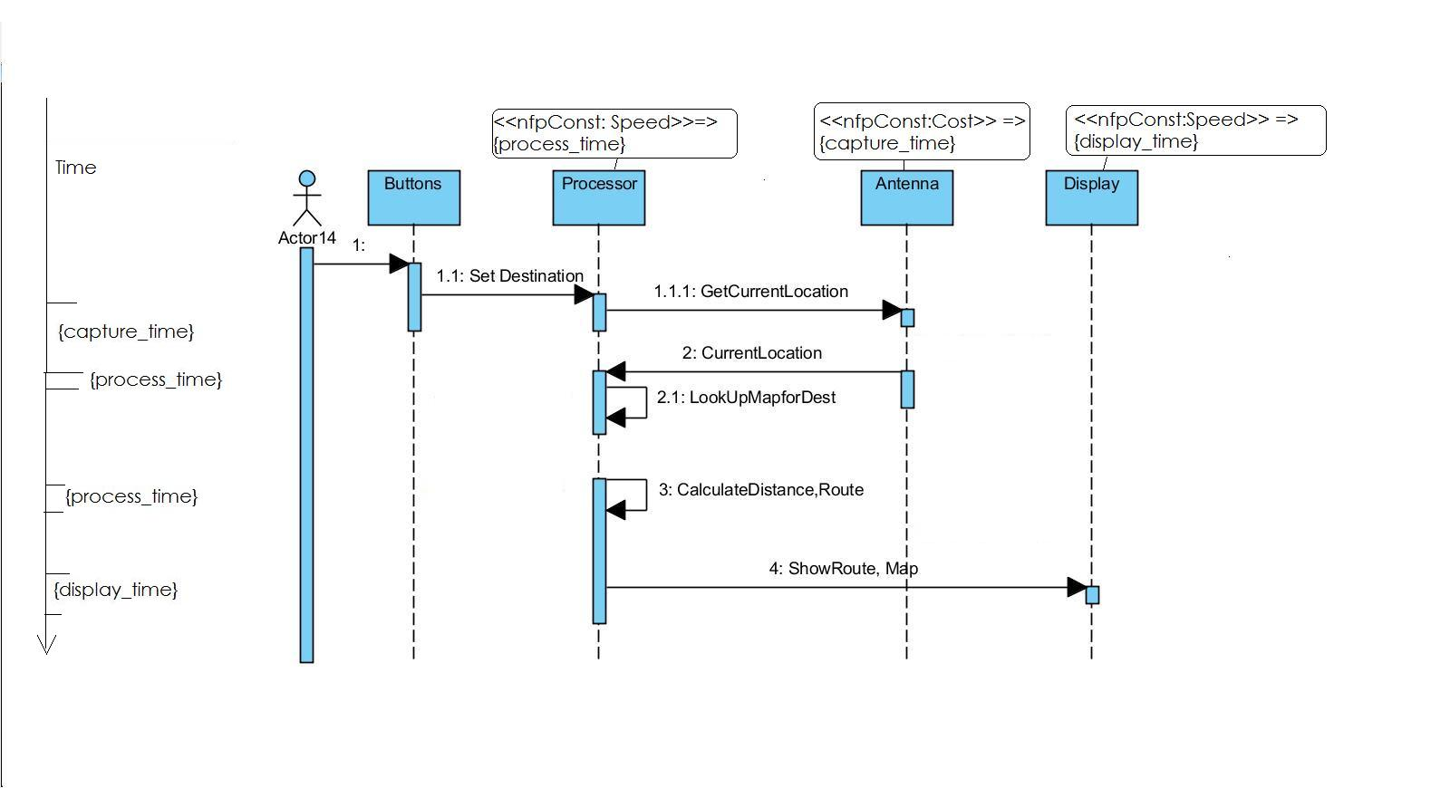
GPS
Annotated sequence diagram

Slide 38
Weighted constraint charts for GPS

Slide 39
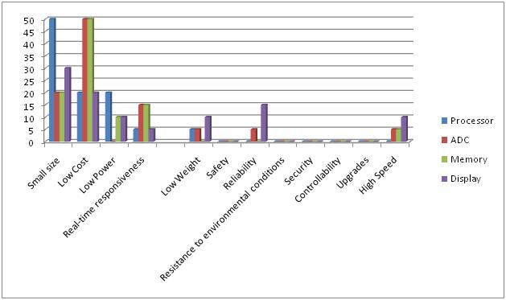
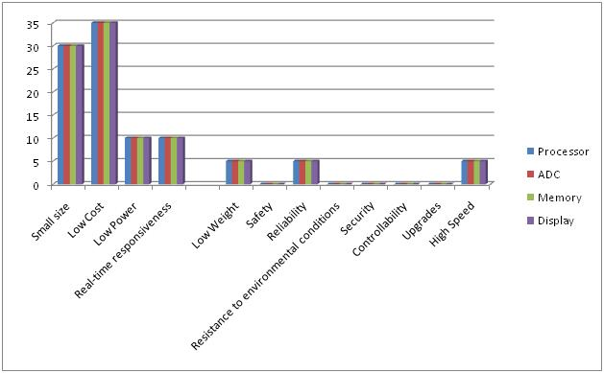
Weighted constraint charts for components of GPS

Slide 40
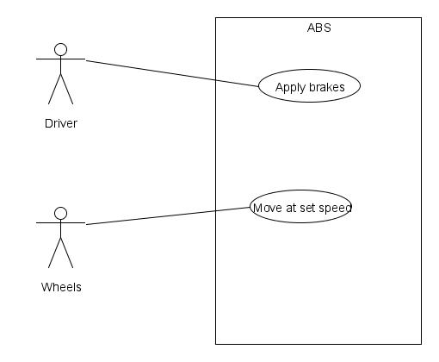
ABS

Slide 41
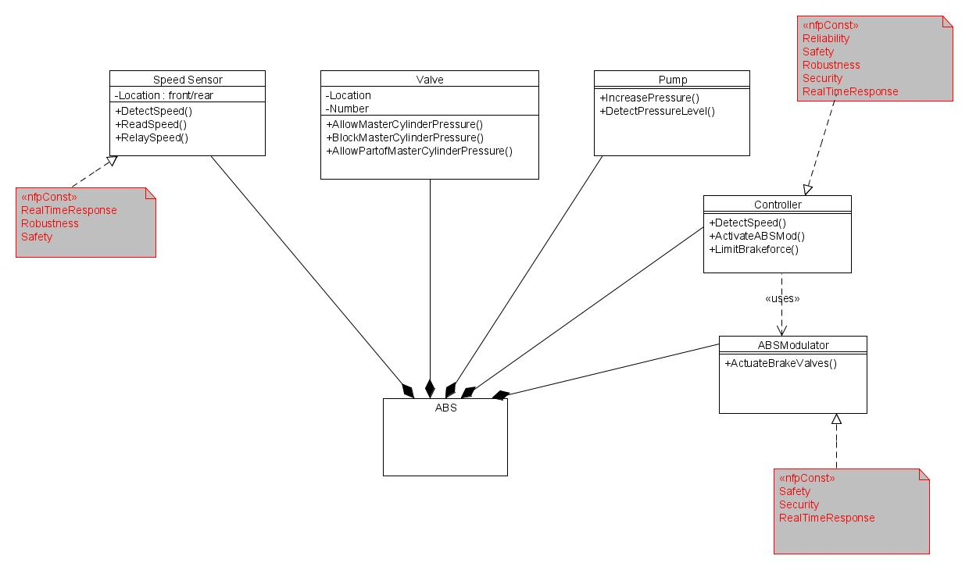
ABS

Slide 42
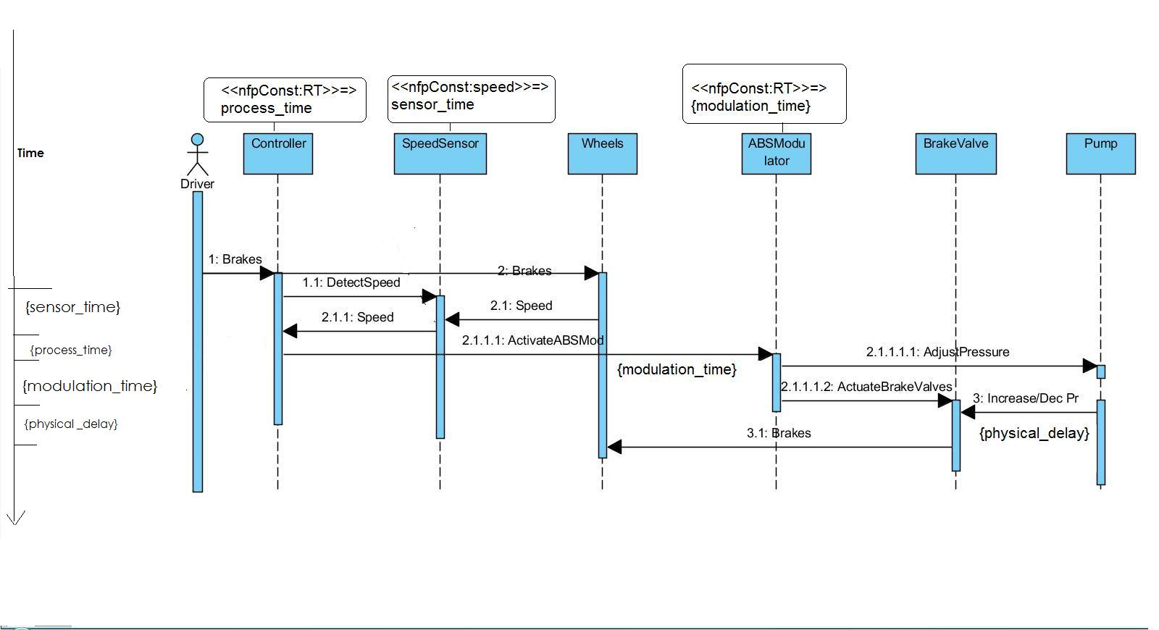
ABS
Annotated sequence diagram

Slide 43
Weighted constraint chart for ABS

Slide 44
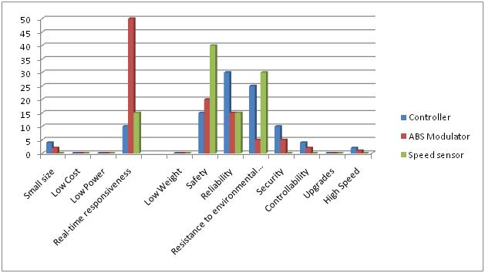
Weighted constraint chart for components of ABS

Slide 45
Conclusions
Annotating class diagrams and sequence diagrams with NFPs and NTPs helps in understanding the dependencies
Weighting the constraints aids in making better design and implementation choices

Slide 46
Future work
Standard weighting scales have to evolve
Need a better way of representing qualitative NTPs.
Tools?

